Slide 1
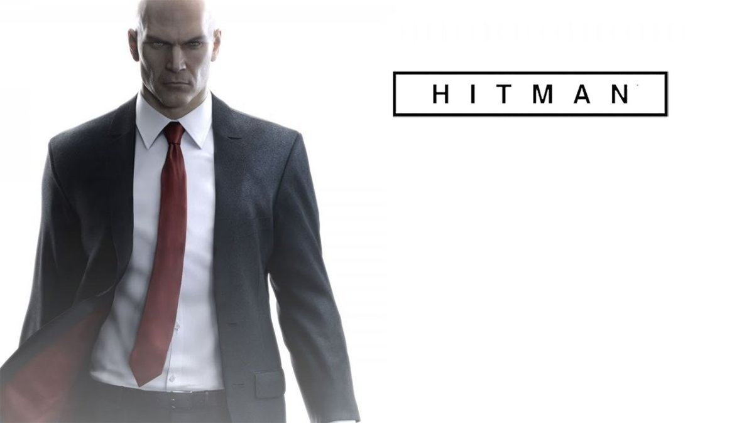
Metin Özmutlu
1803502

Slide 2
SEVEN USABILITY PILLARS

Slide 3
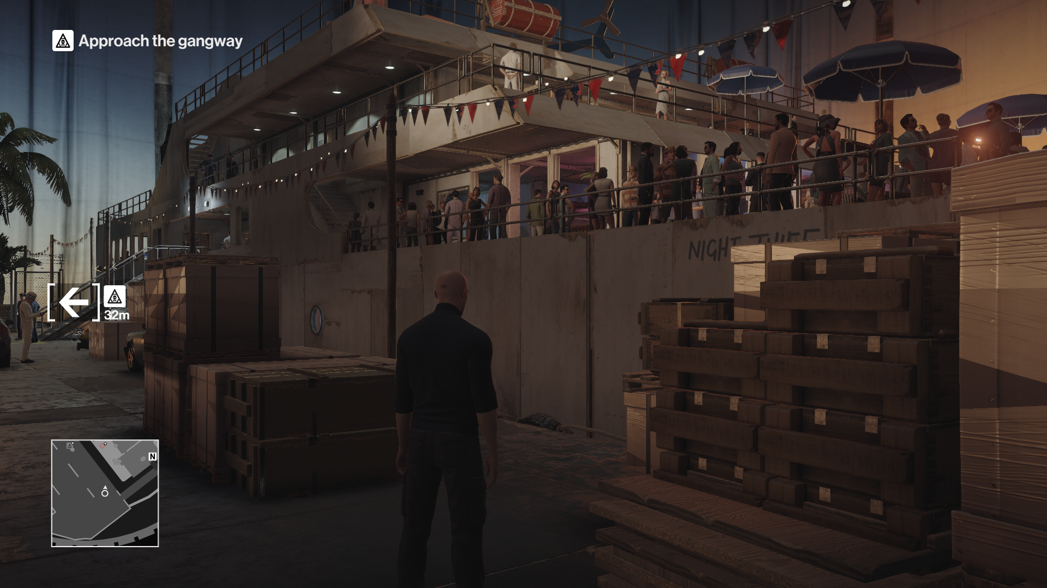
Signs
Thanks to the sings in the game, we;
Can see the enemies around us
Our missions
The way we have to go
can learn

Slide 4
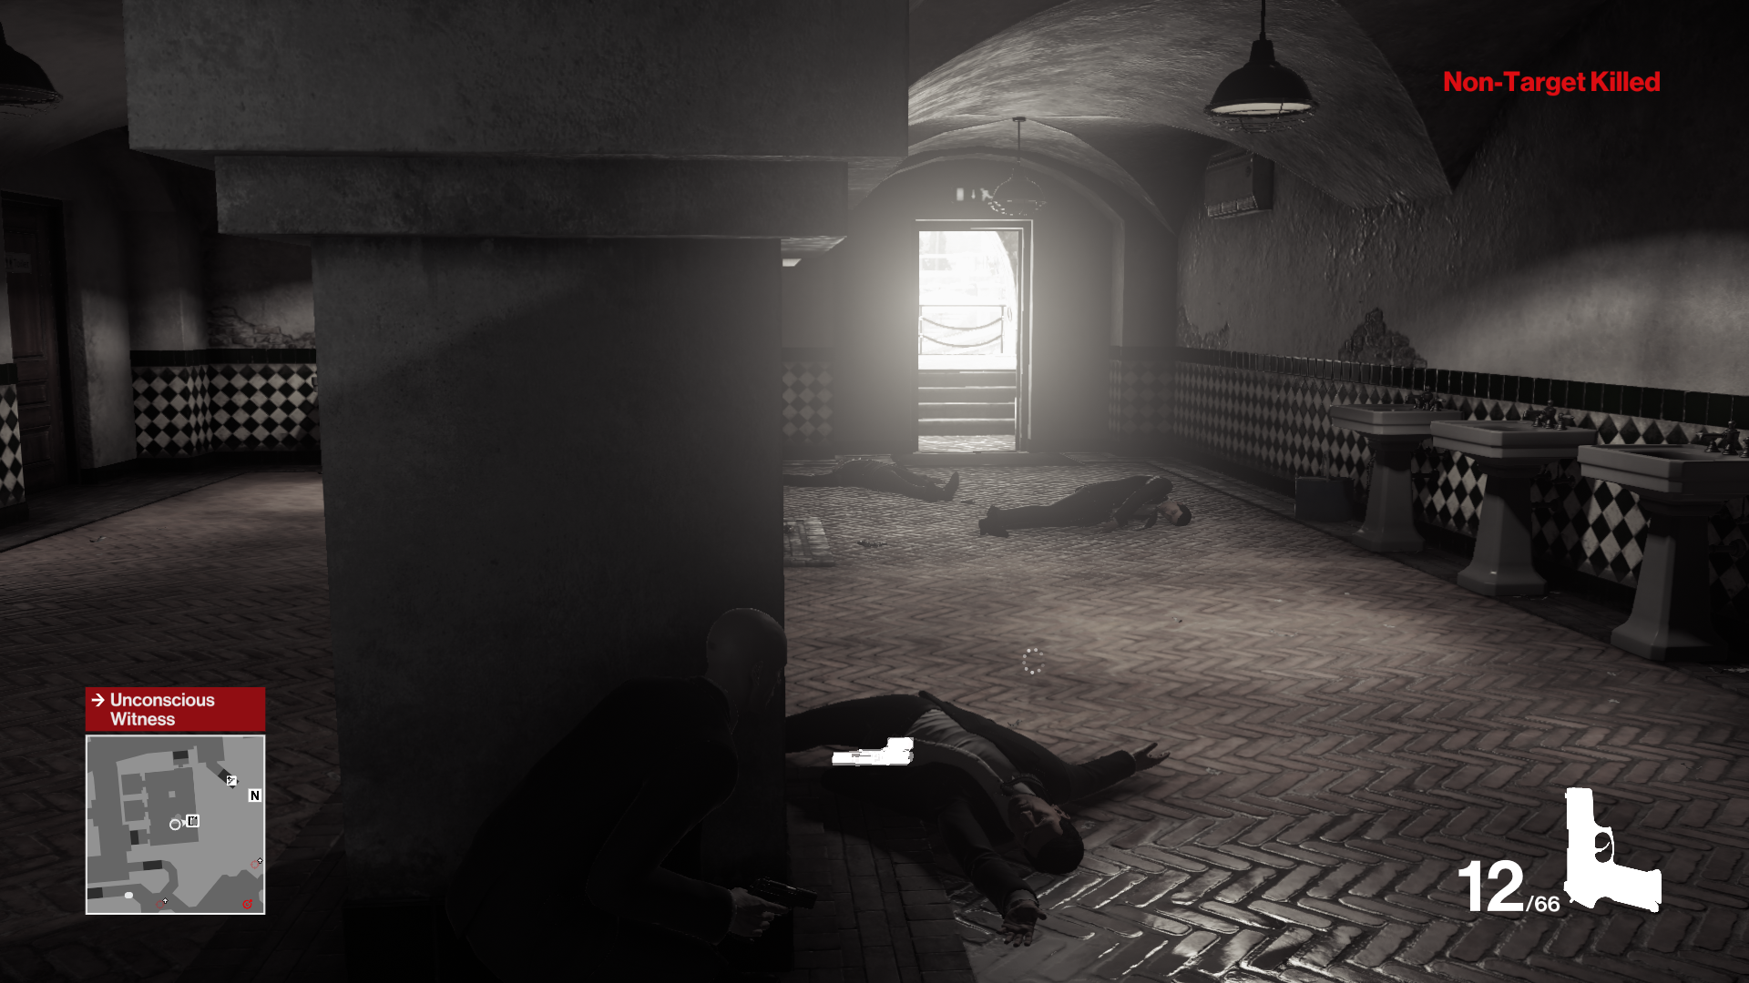
Feedback
It gives us information about the number of bullets left and the number of items in our inventory.
It gives information at the top right when we kill someone with or without a target.
If there is a problem with our privacy at that moment, it indicates what it is.

Slide 5
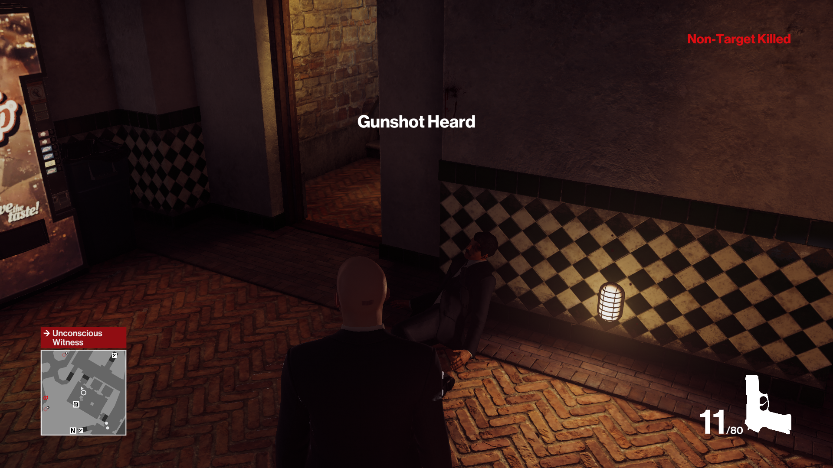

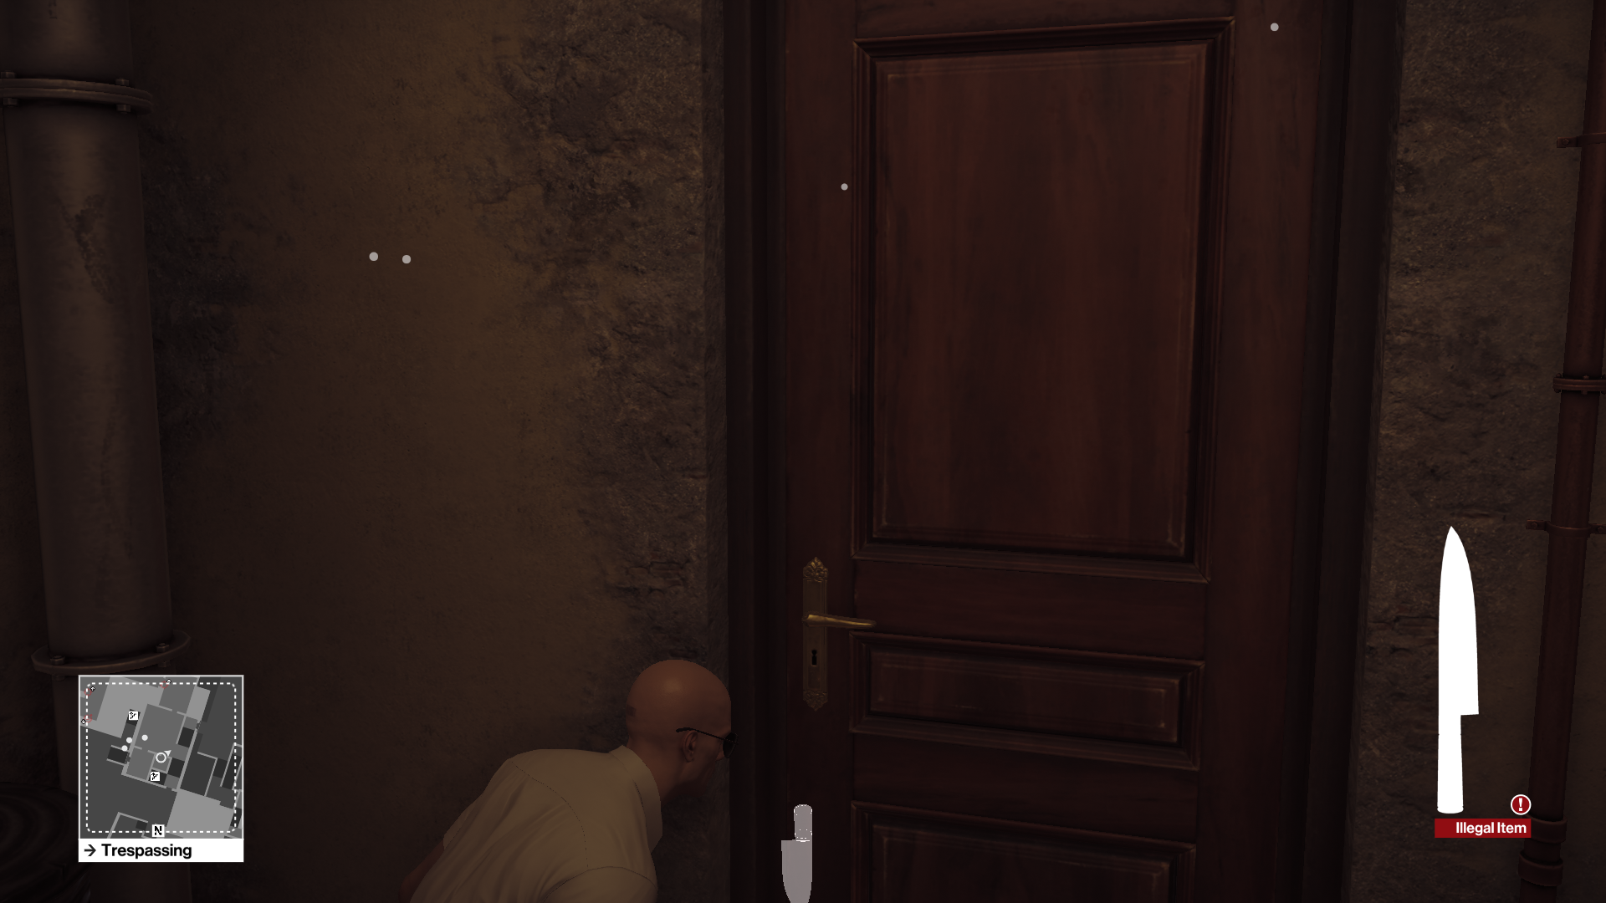
Clarity
A special article appears that we are in danger or are being searched.
It gives a warning that when we take a weapon or a bomb in our hands, we may be catch.

Slide 6
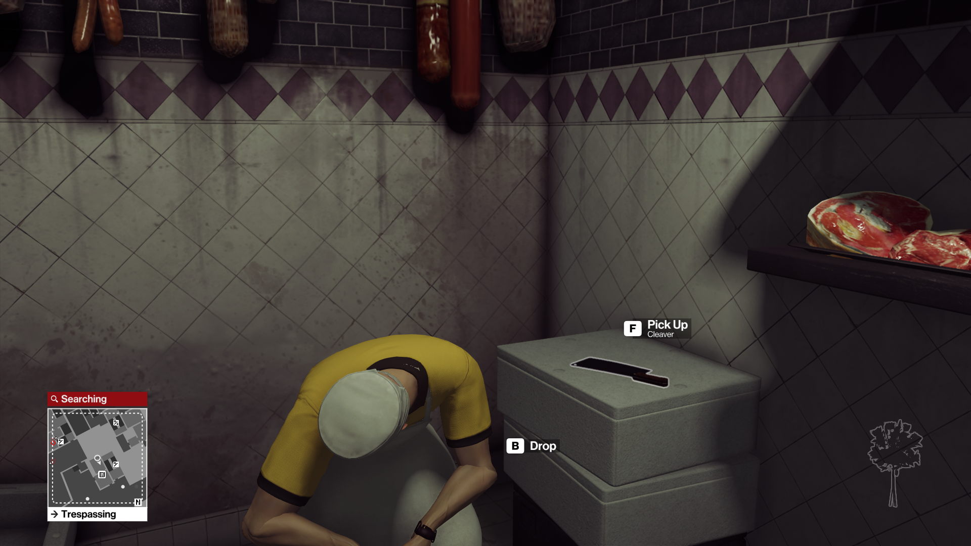
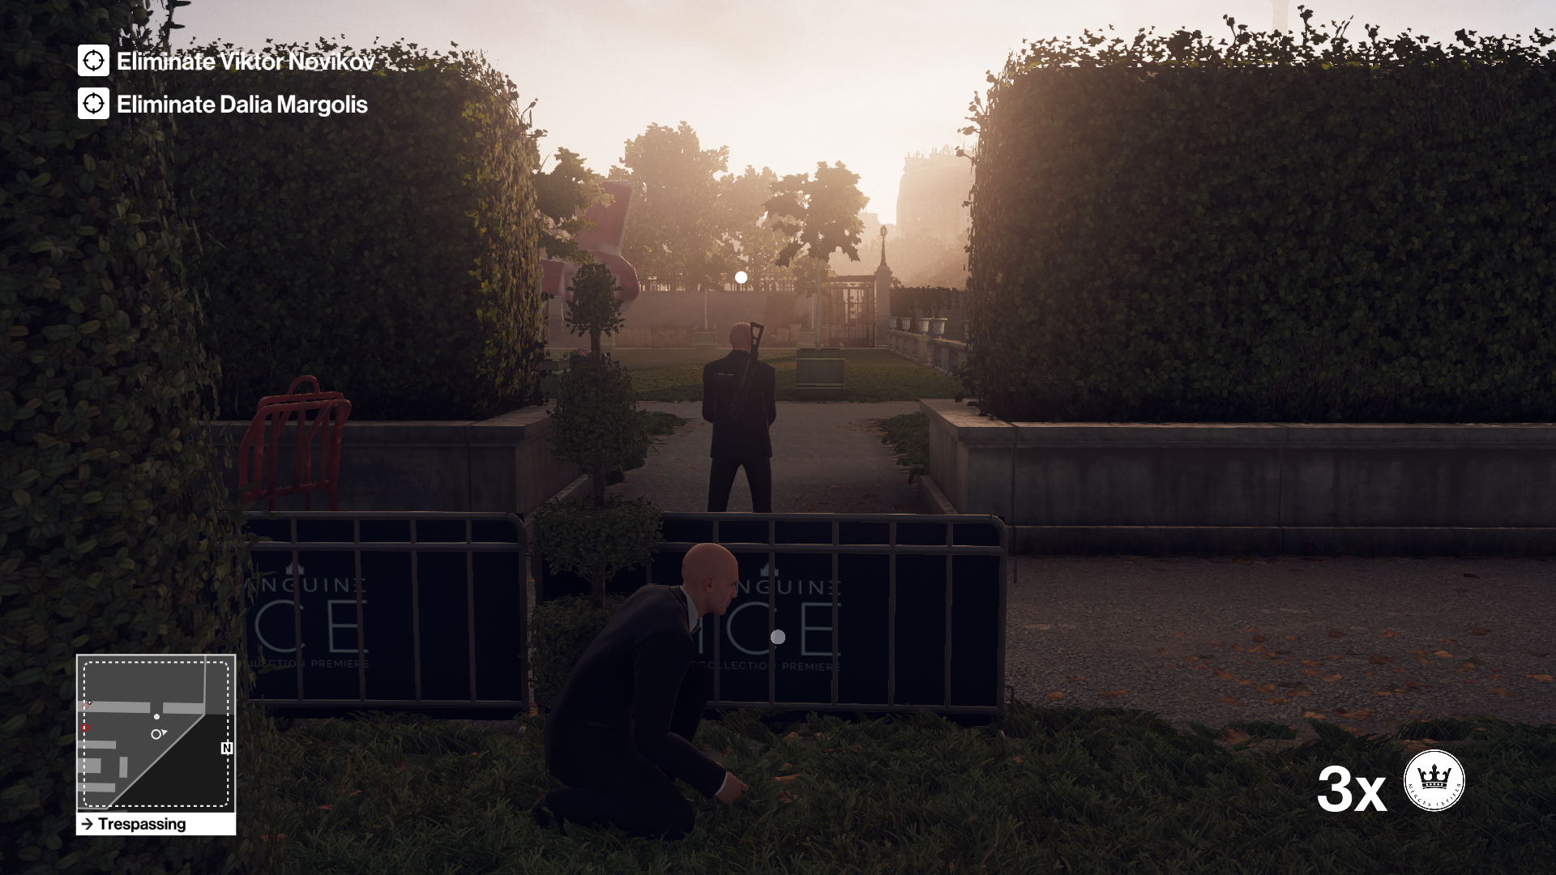
From Follows Function
Weapons and materials that we can use in the game are surrounded by white, and it seems to be the button that we can interact with when we get closer.
The difficulty of killing enemies varies because they have different types of weapons.

Slide 7
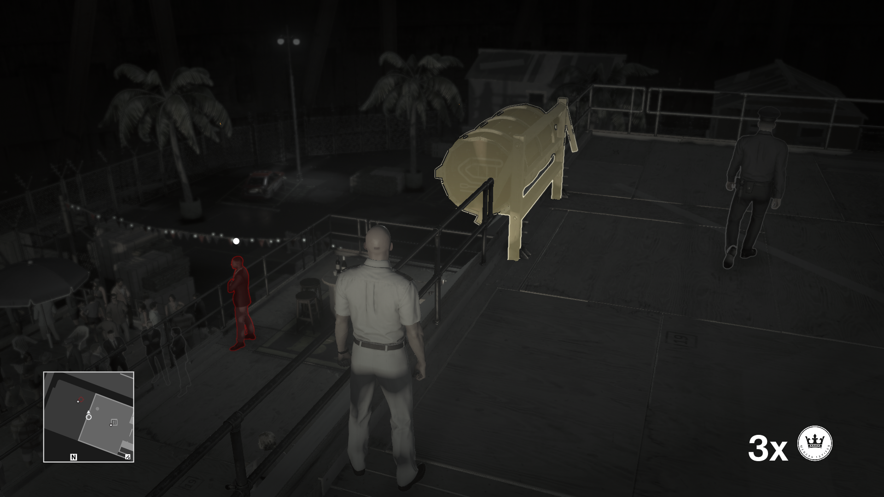
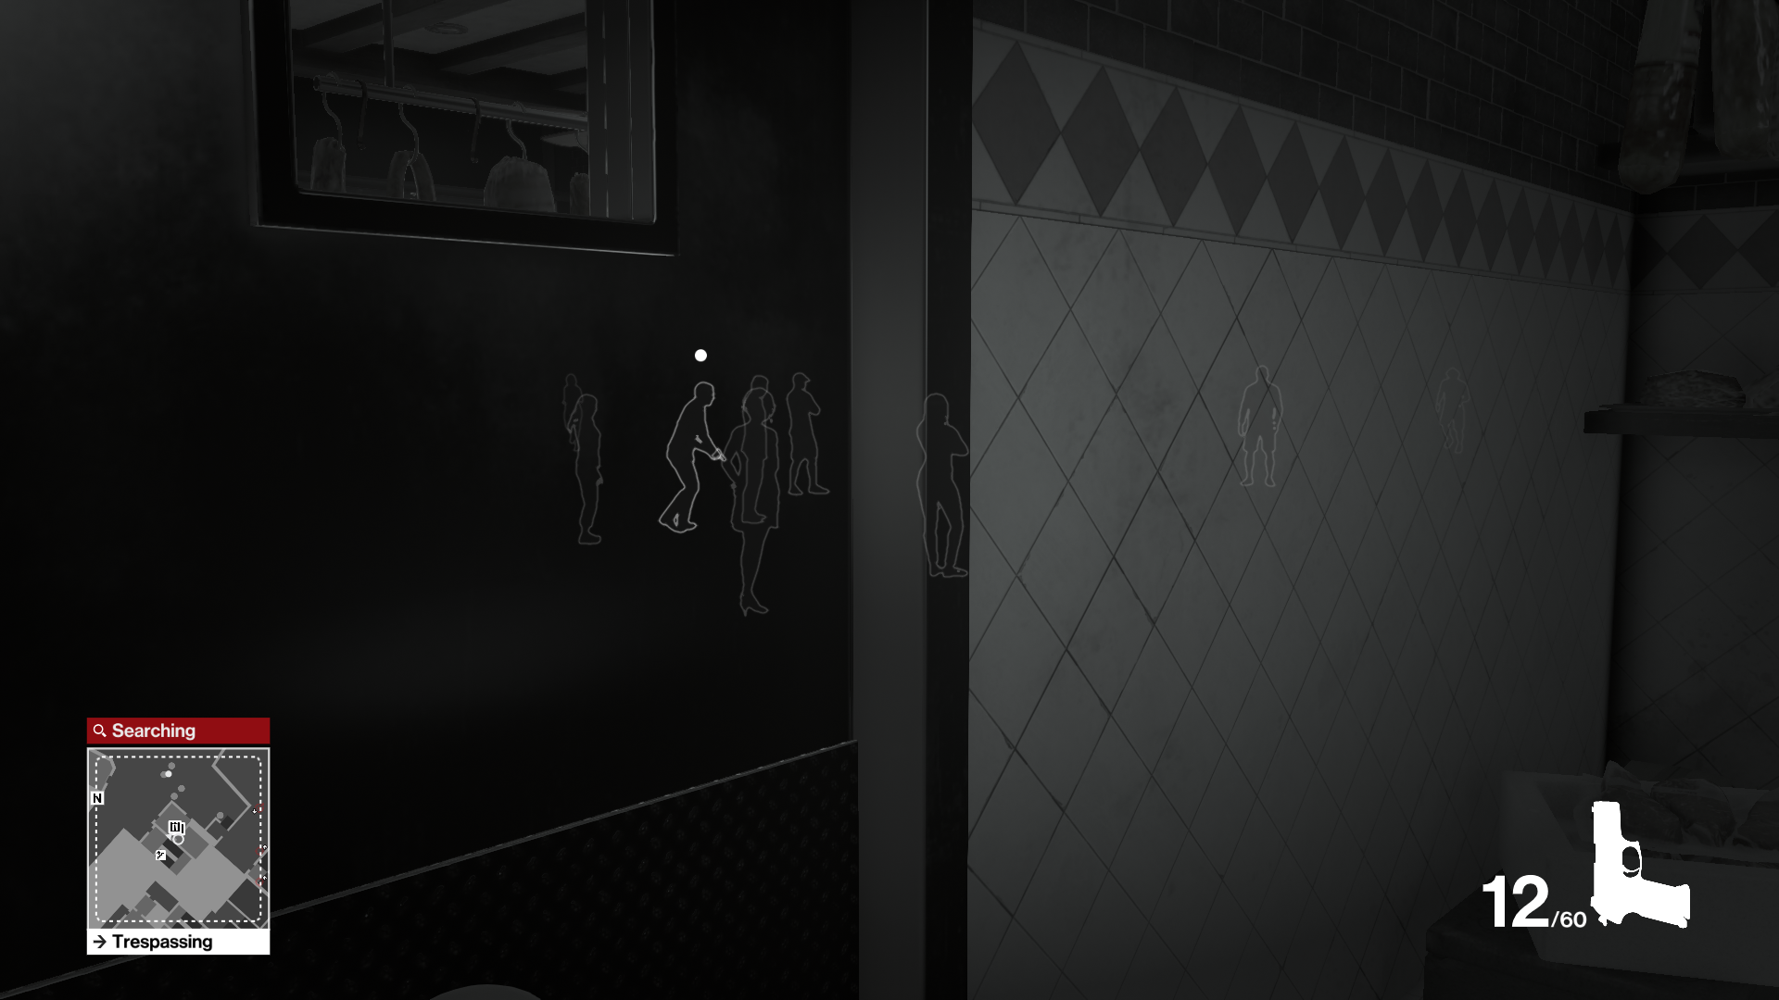
The enemies that can catch we are white, the target we need to kill is red, and the items we can interact with are yellow around them.

Slide 8

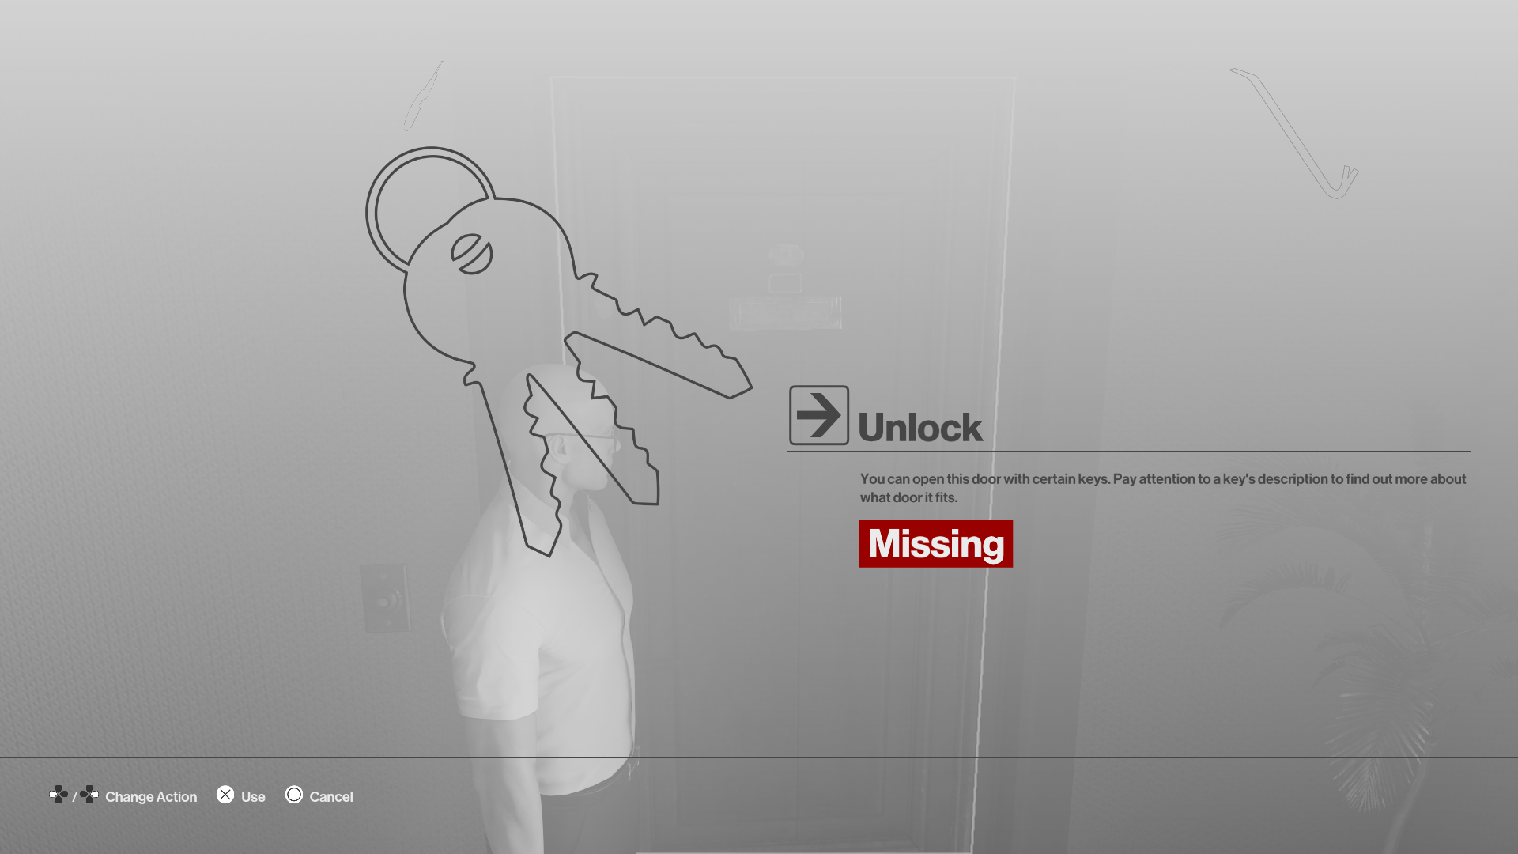
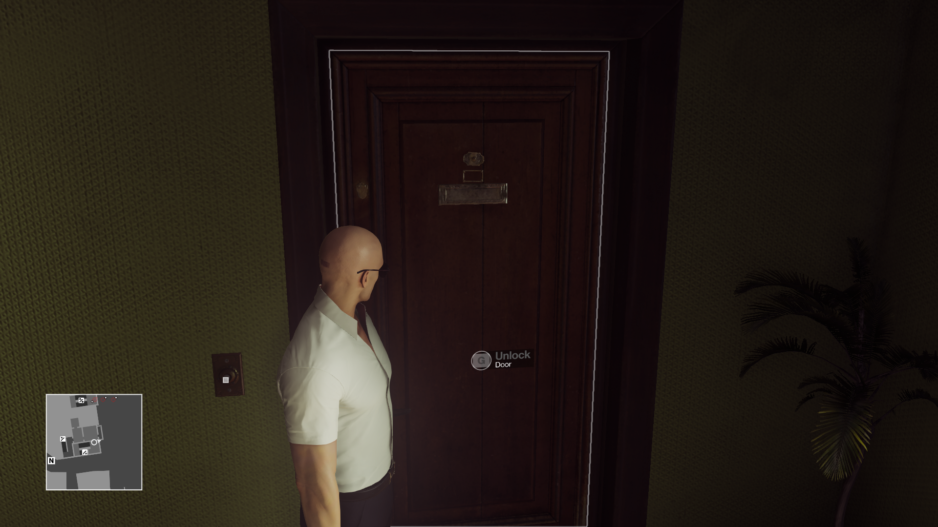
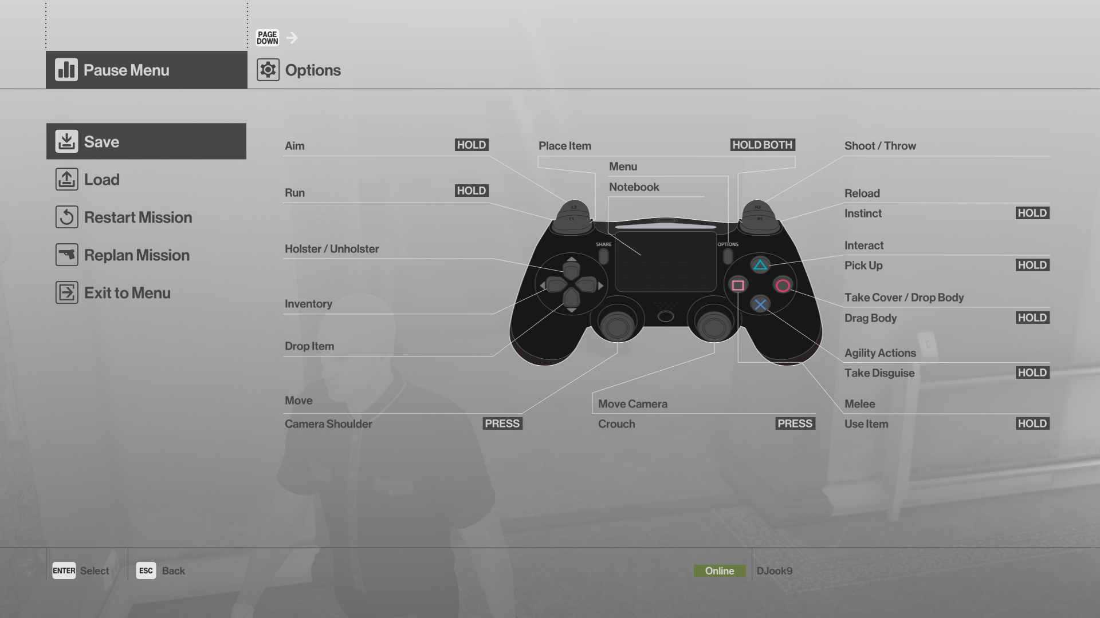
Consistency
When we enter the pause menu in the game, we see the controls. Controls are described by buttons in an understandable way
We can open doors in the game if they are not locked. If it is locked, we must have a lockpick or keys.

Slide 9
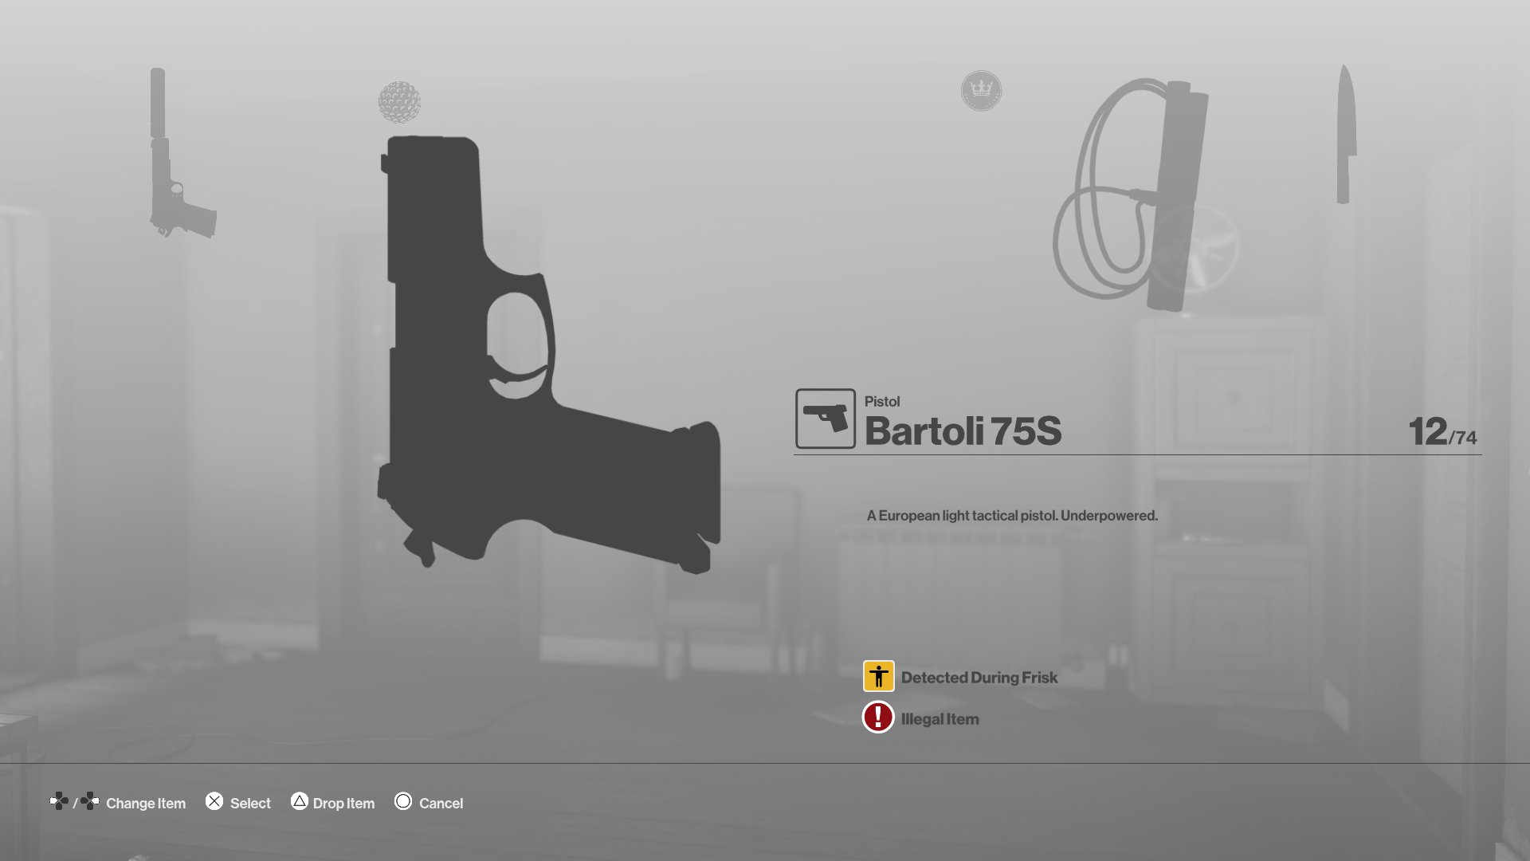
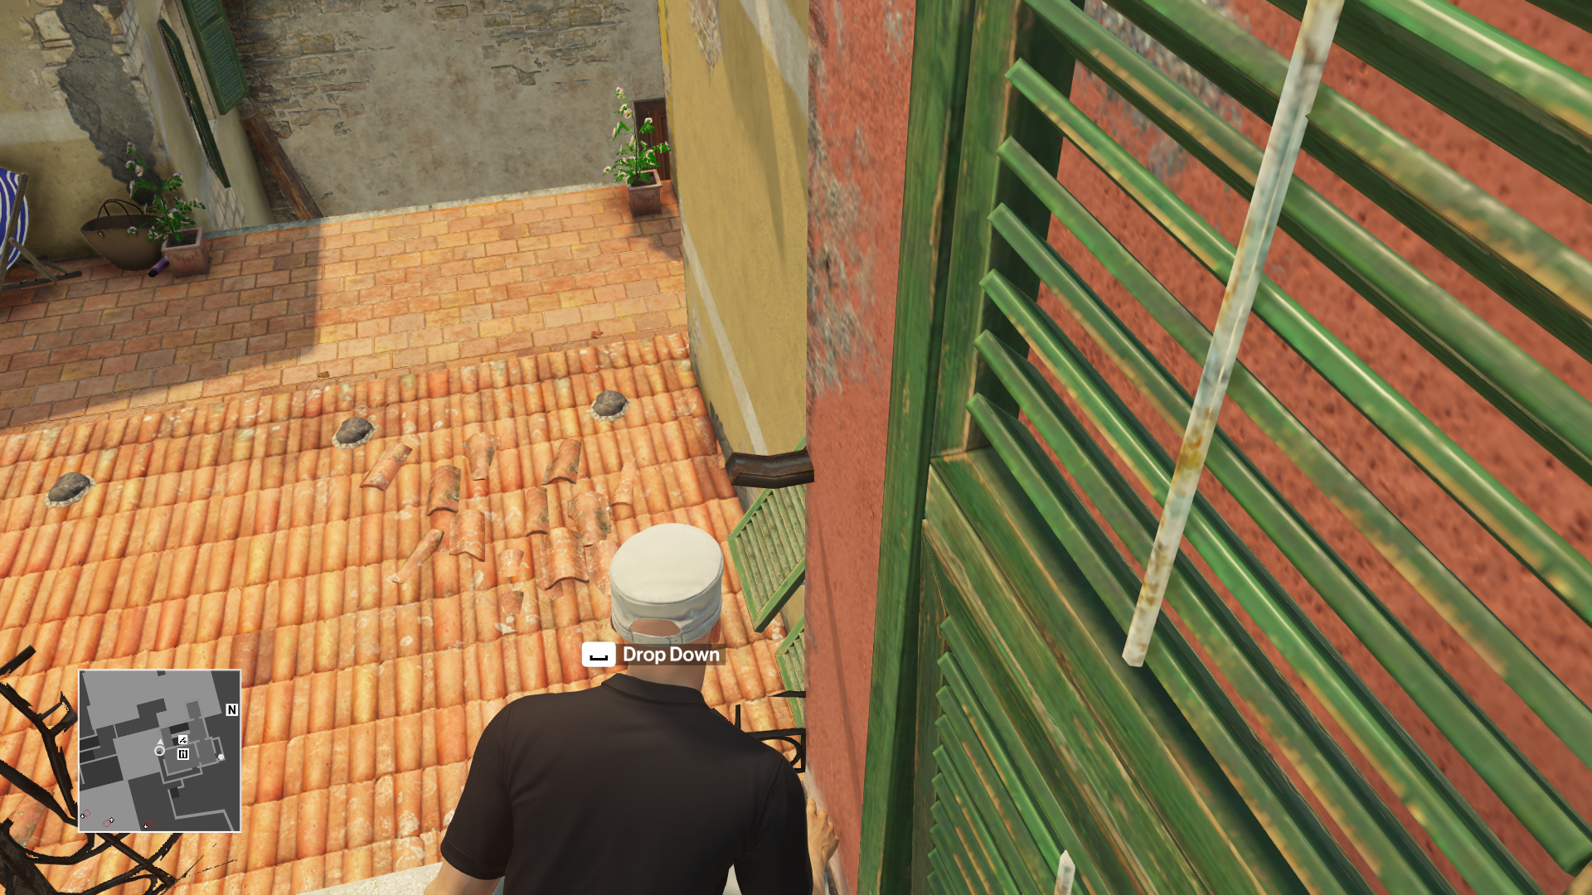
Minimum Workload
The buttons that we will use to perform actions appear next to our character.
When we want to change weapons, it is not enough just to open the weapon selection screen. After selecting the desired weapon and confirming the weapon of our choice, we can return to the game.

Slide 10
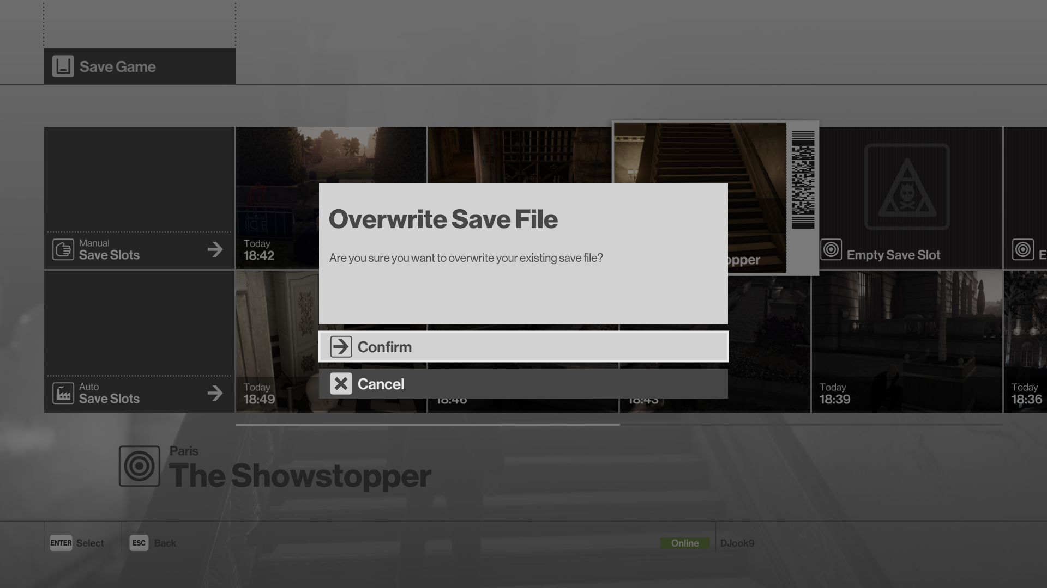
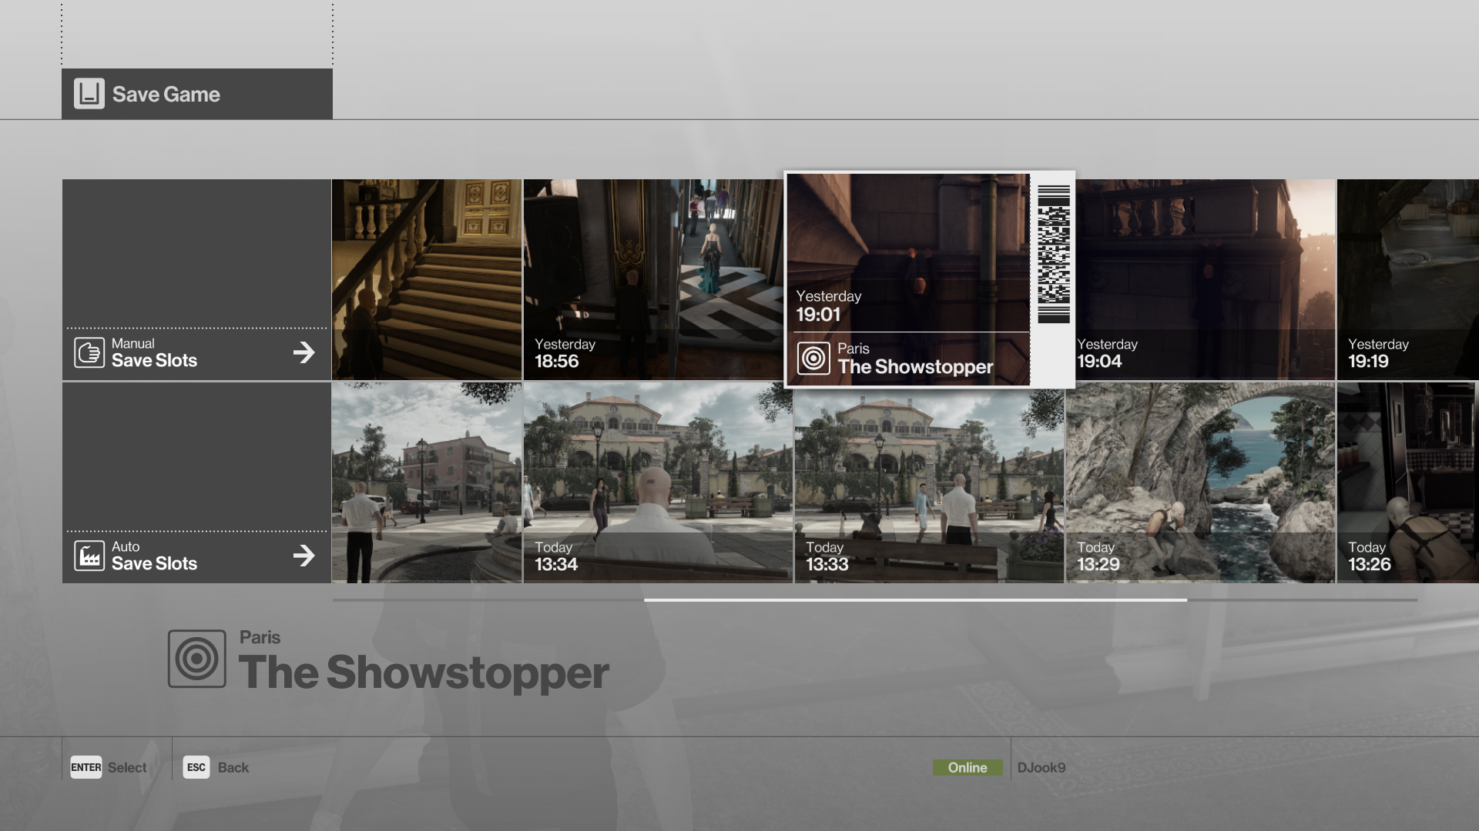
Error Prevention and Recovery
The save system of the game is quite easy and fast. After pressing the options button, we can save it to any save slot we want.
If there is a pre-saved save in the save slot, the game asks us if we can save it overwrite the existing file.

Slide 11
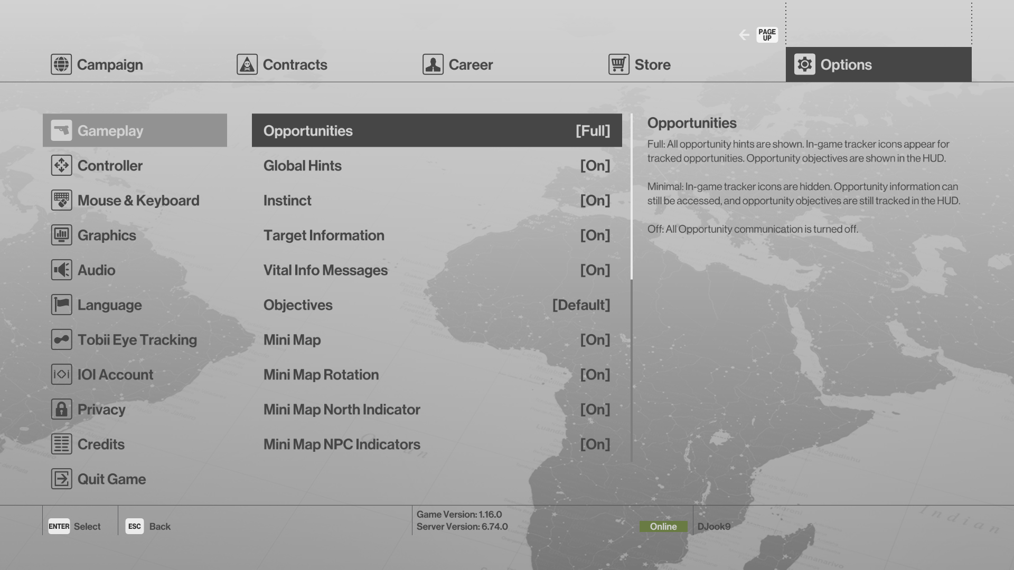
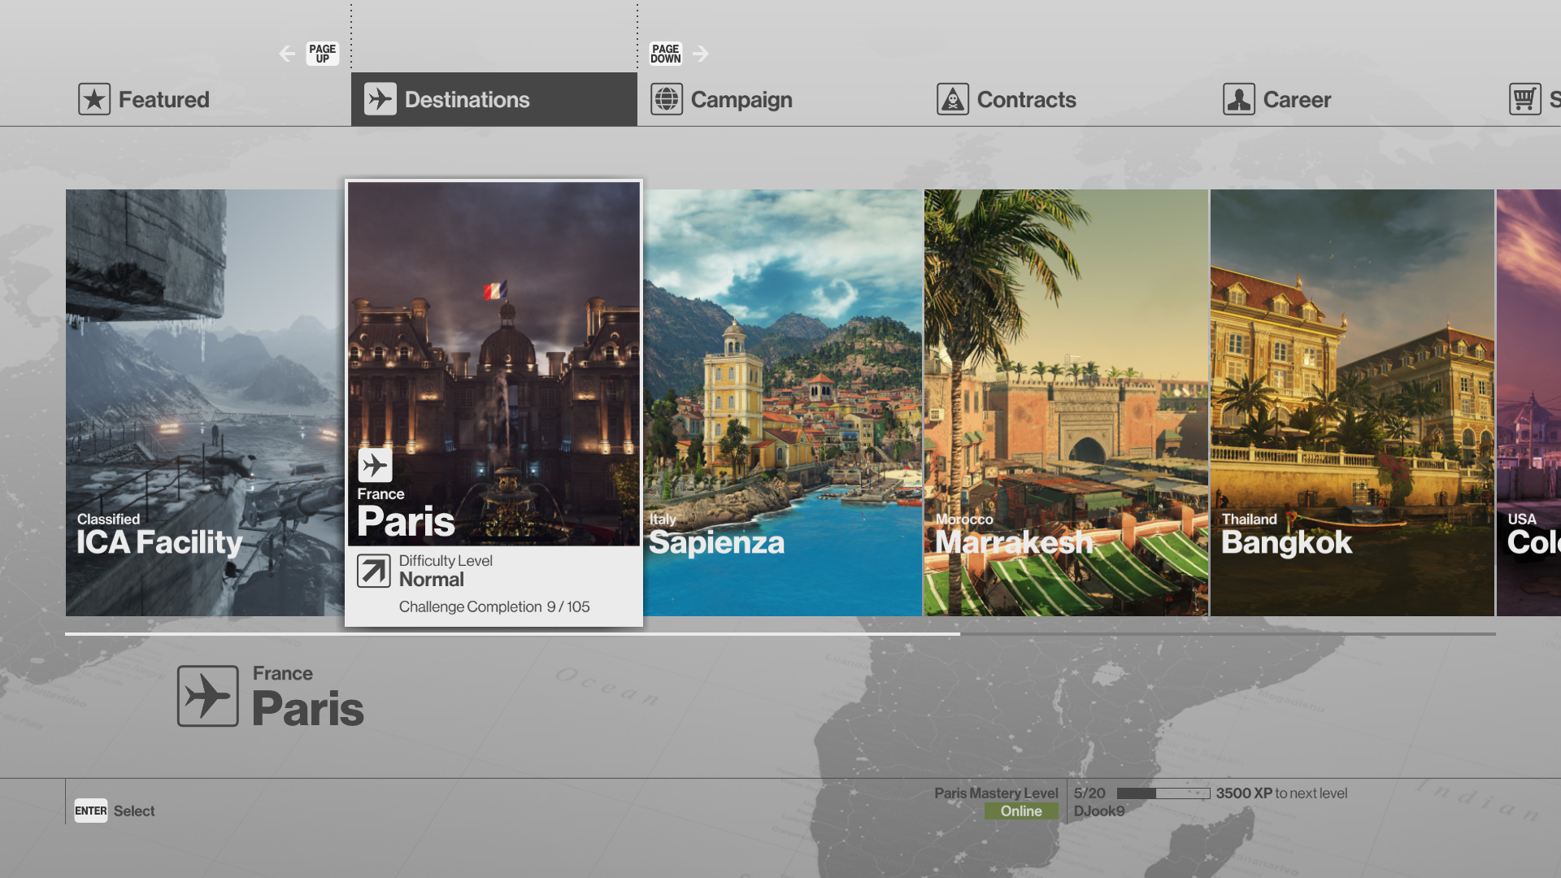
Flexibility
Although the game settings are customized as we wish, there are no difficulty settings in the game.
We have the opportunity to replay the episodes we want from the menu.

Slide 12
ENGAGE ABILITY

Slide 13
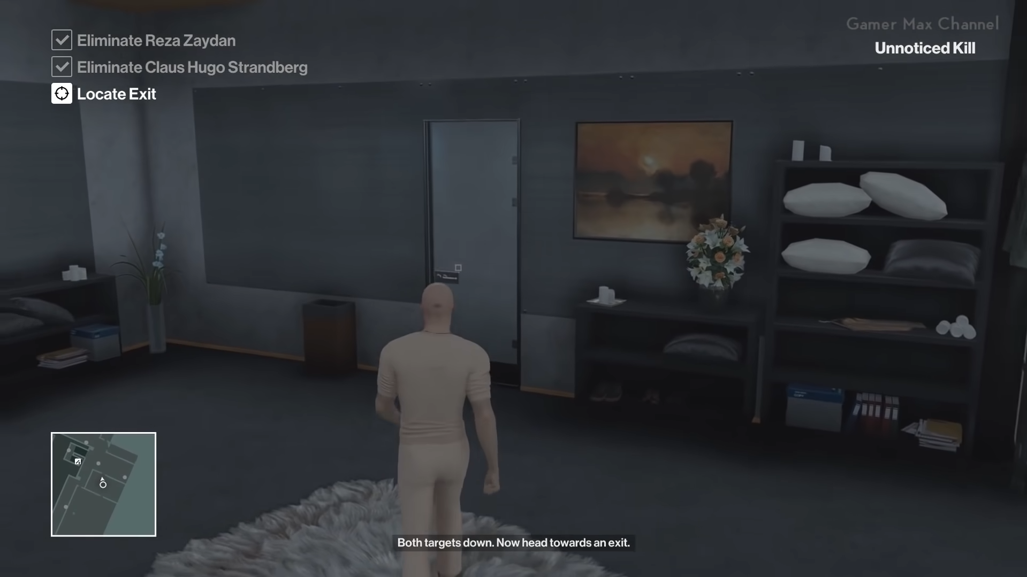
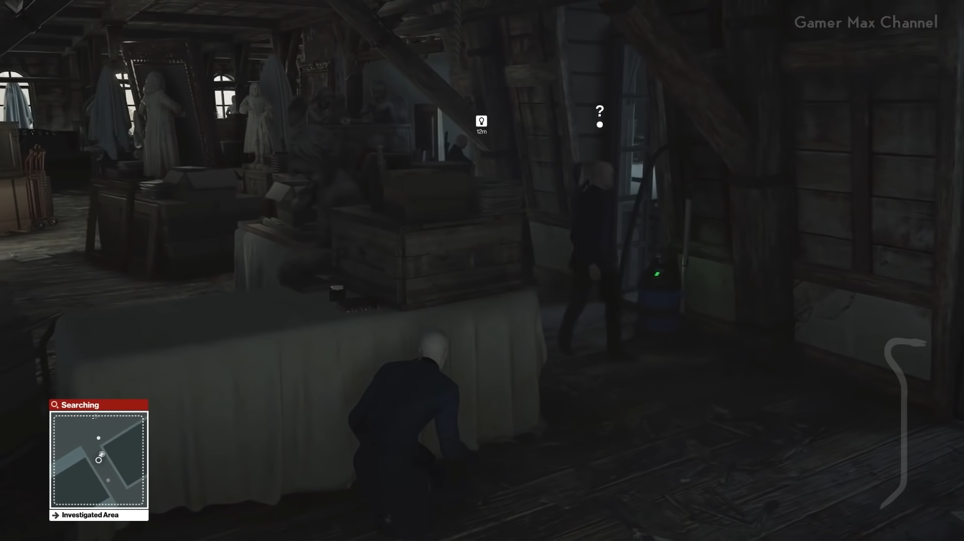
Intrinsic Motivation
Competence
As you play the game, the player gains experience. In this case, it allows him to more easily complete missions in the game.
A cursor appears to the player when his mission is finished and indicating the new mission he needs to do.
With the use of objects that will make sounds to attract enemies to ourselves, the player can make tactics to his enemies.

Slide 14
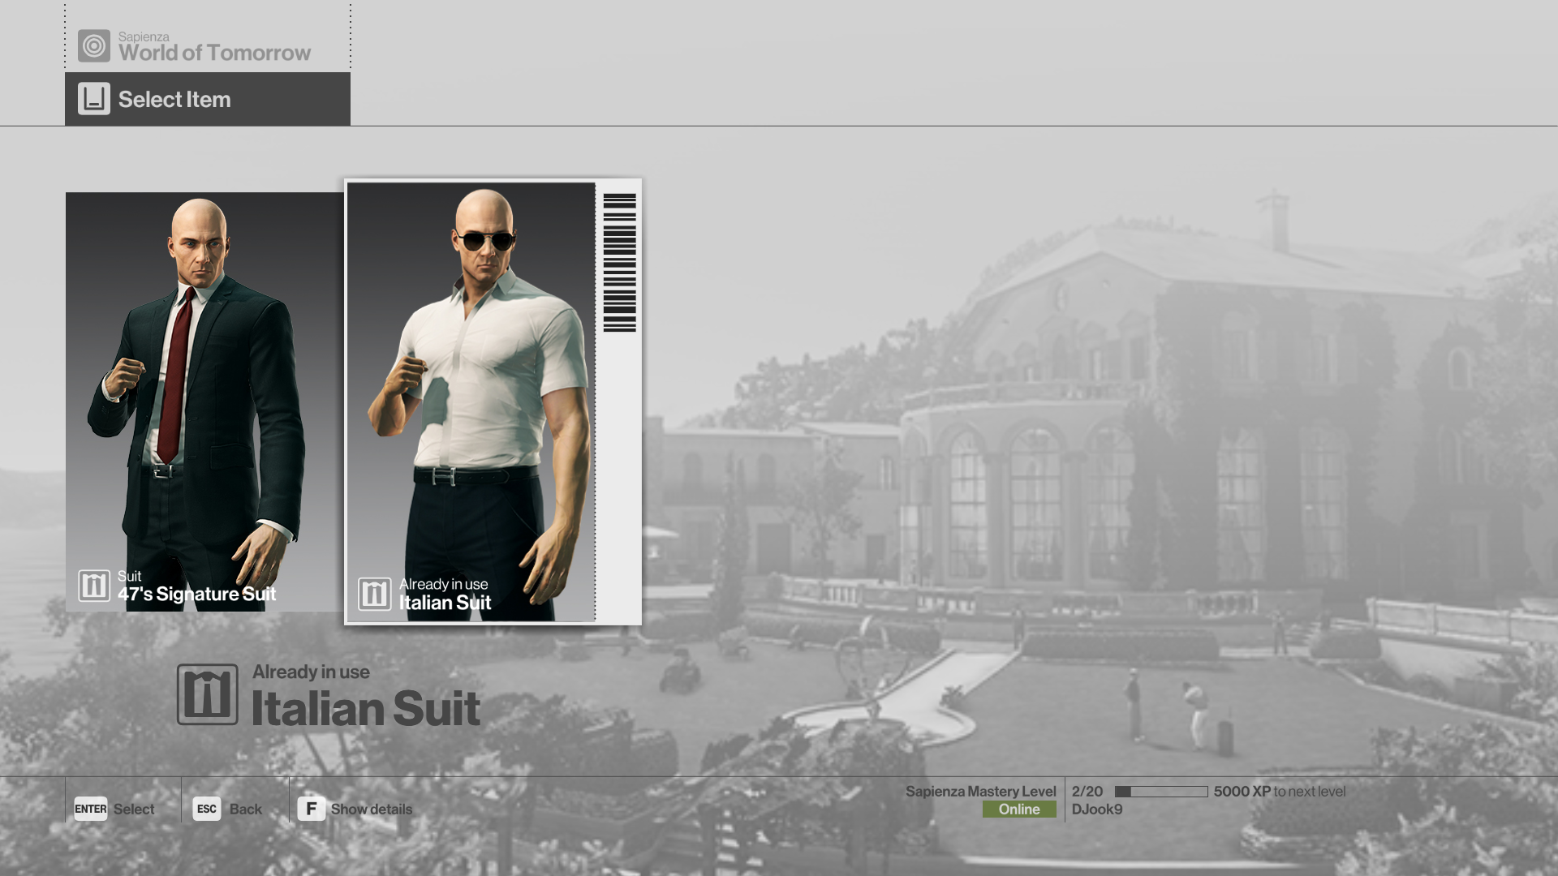
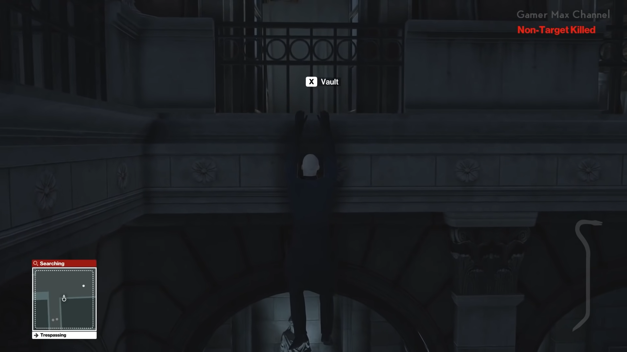
Intrinsic Motivation
Autonomy
When killing a player's target in the game, the situation of killing those who non-target depends on the player's choices.
Character customization is limited, we can only choose the costume we will wear when starting the mission.

Slide 15
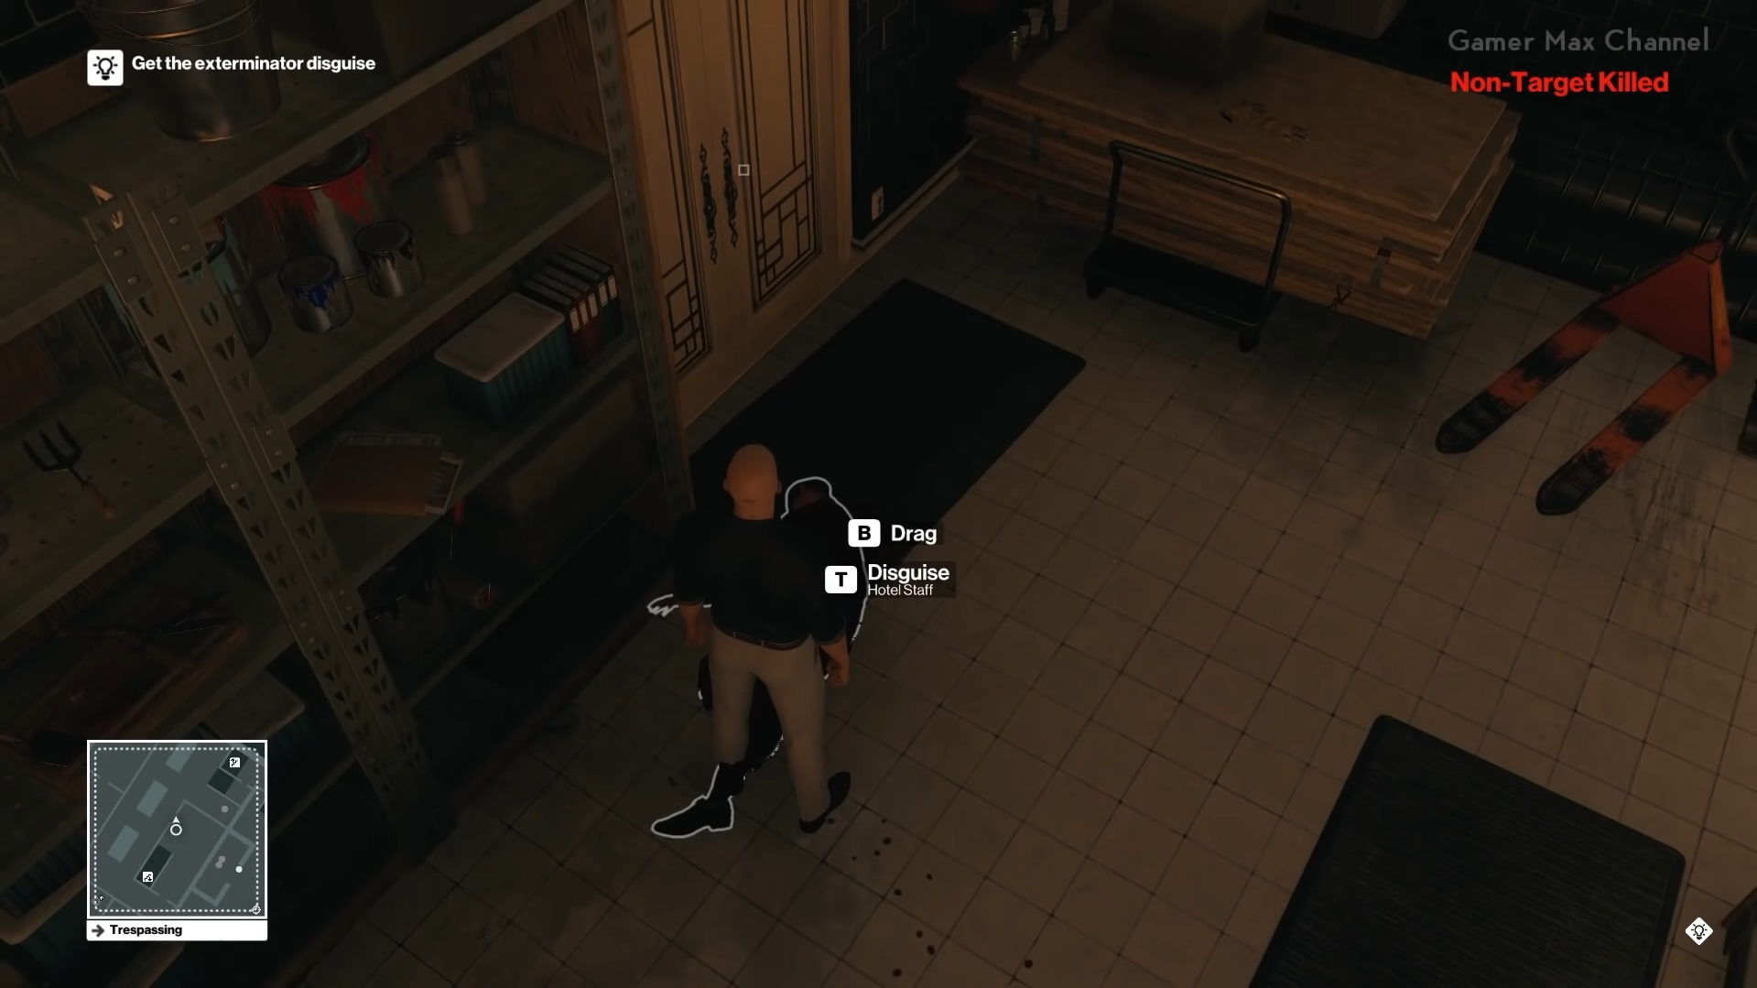
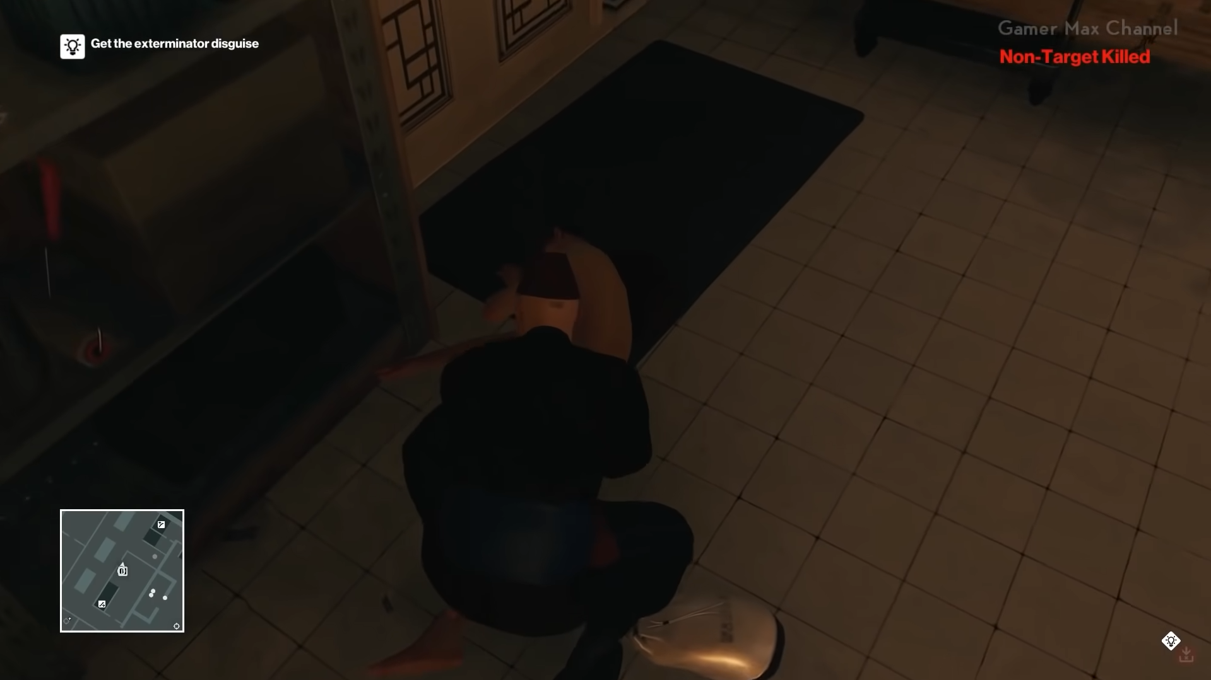
When a player kills an NPC, he can wear his outfit if he wants.

Slide 16
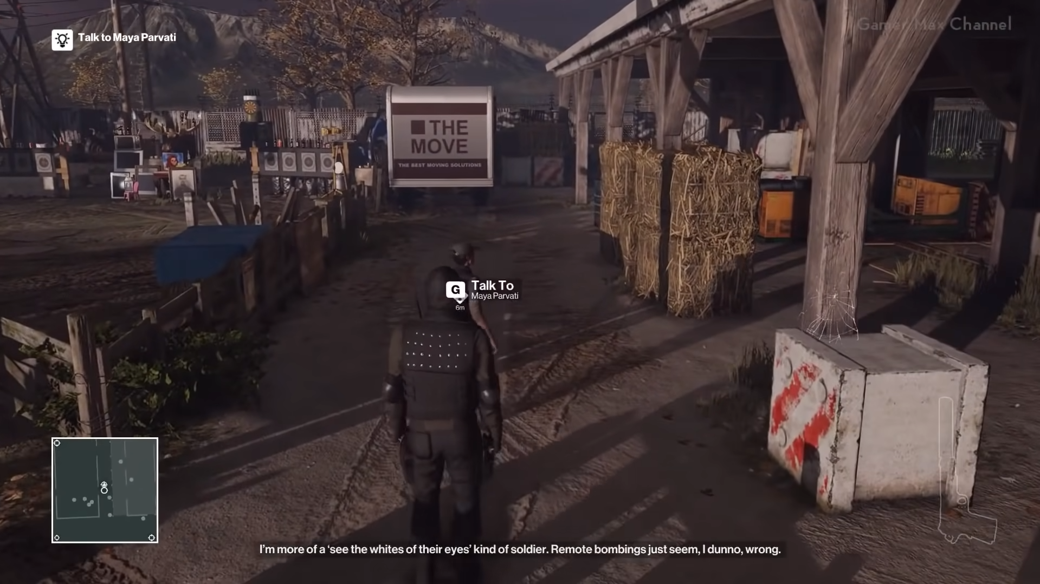
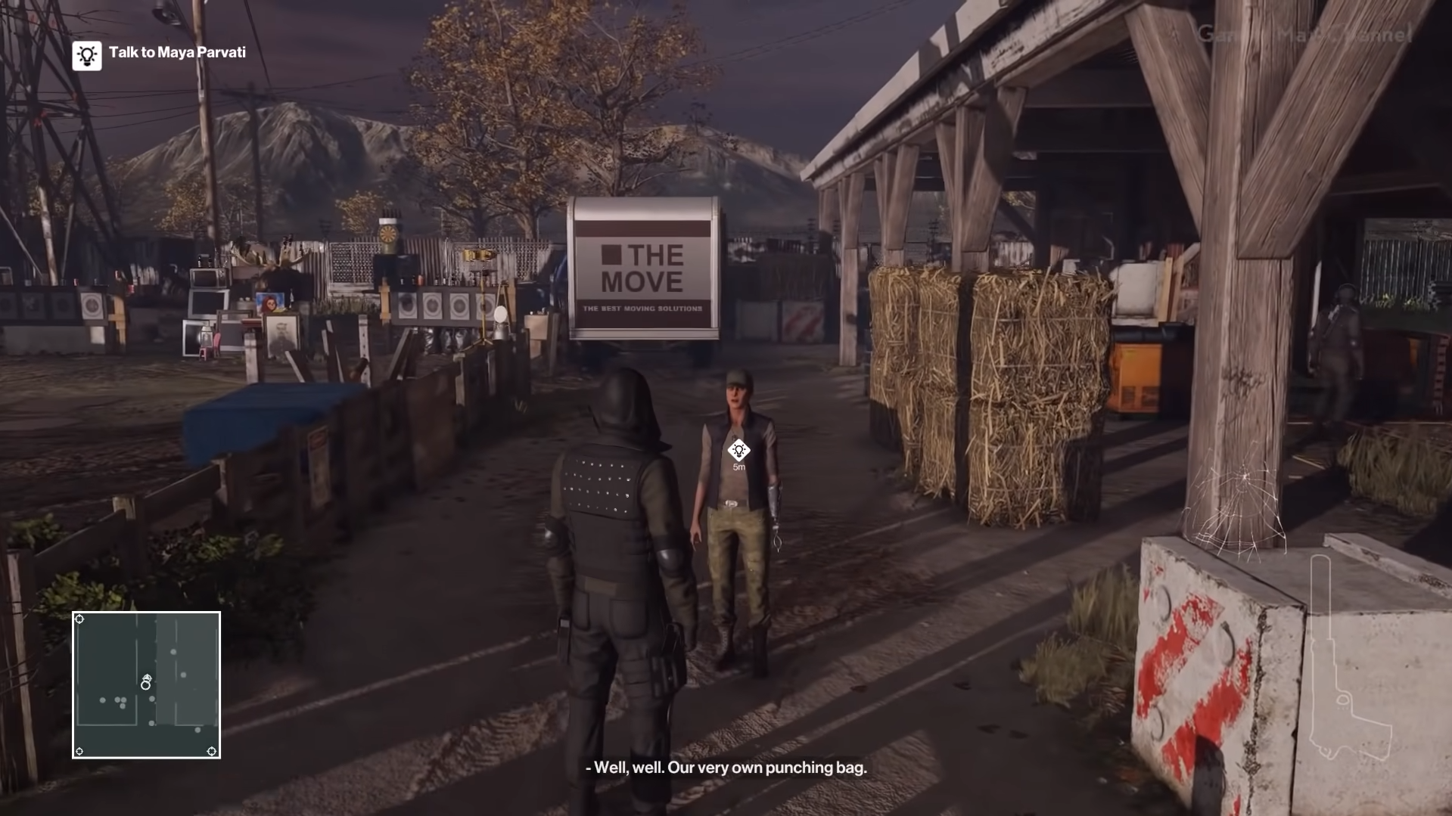
Intrinsic Motivation:
Relatedness:
Since Hitman is a single-player game, there is no socialization with other players in the game. In the game it is possible to talk only with some NPCs.

Slide 17
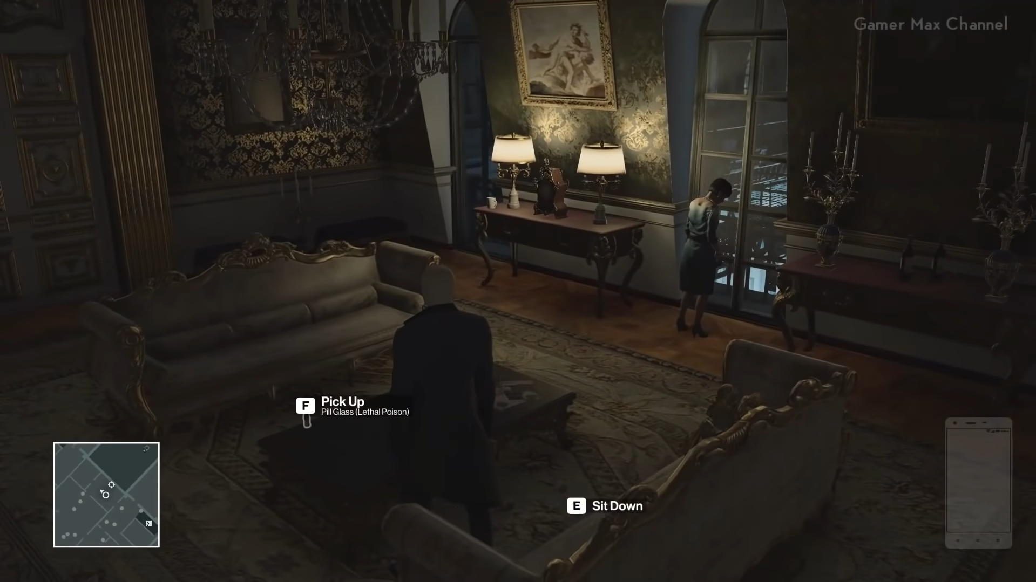
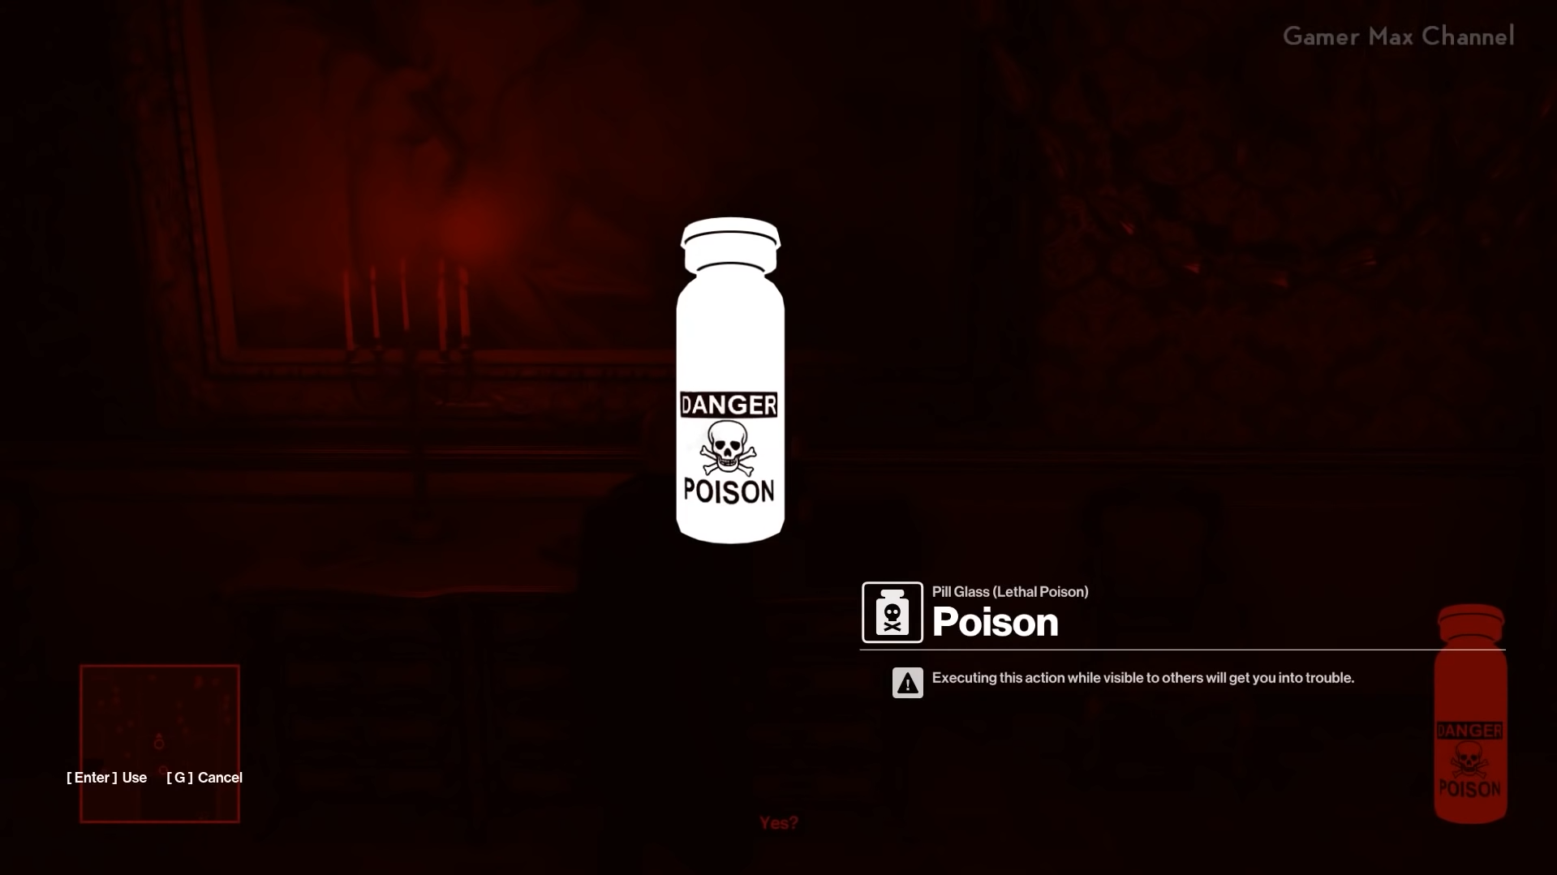
Intrinsic Motivation:
Meaning:
Before the player receives an item, there is a little information about what the item will do.

Slide 18
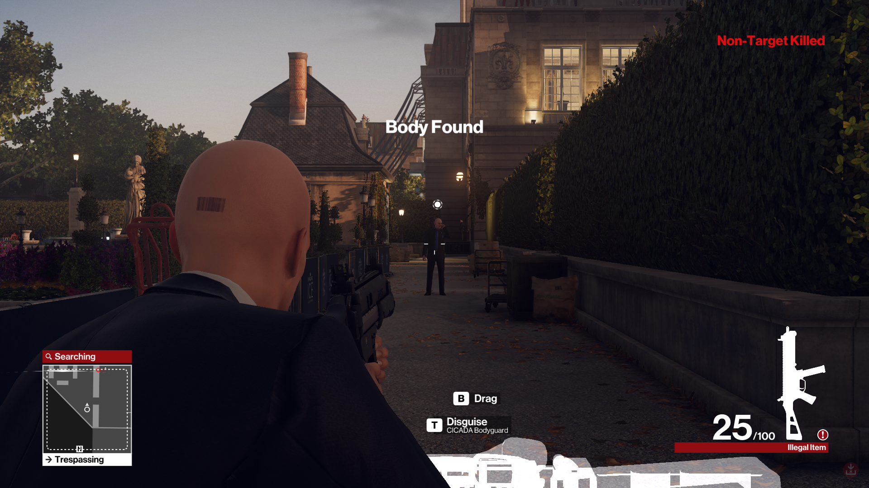
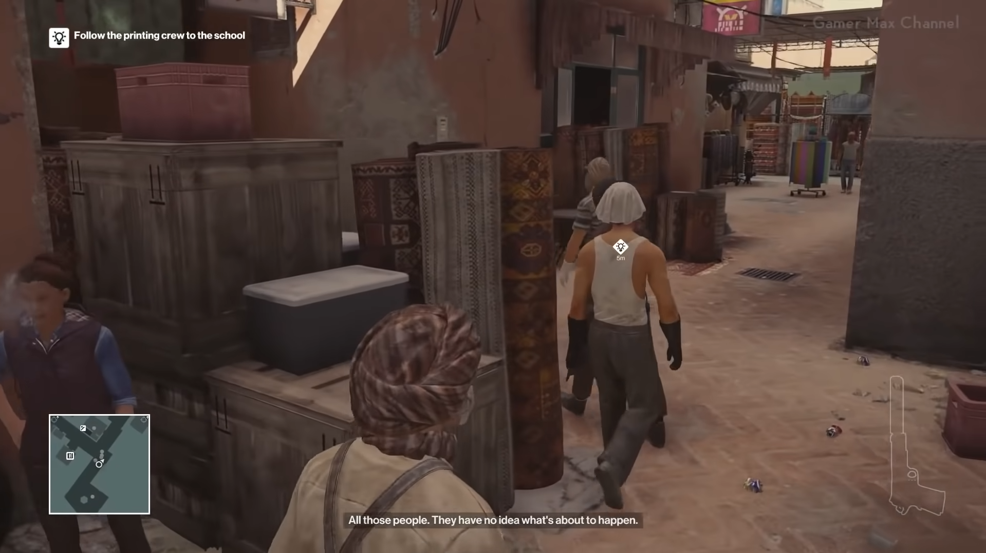
Extrinsic Motivation:
If the player kills his armed enemies, he can take the enemy's weapon.
When the player learns about the opportunities, the game informs the player about the way he can go.

Slide 19
Emotion
Game Feel
Control: The game has the controls that players are used to, and these controls are easy to use.

Slide 20
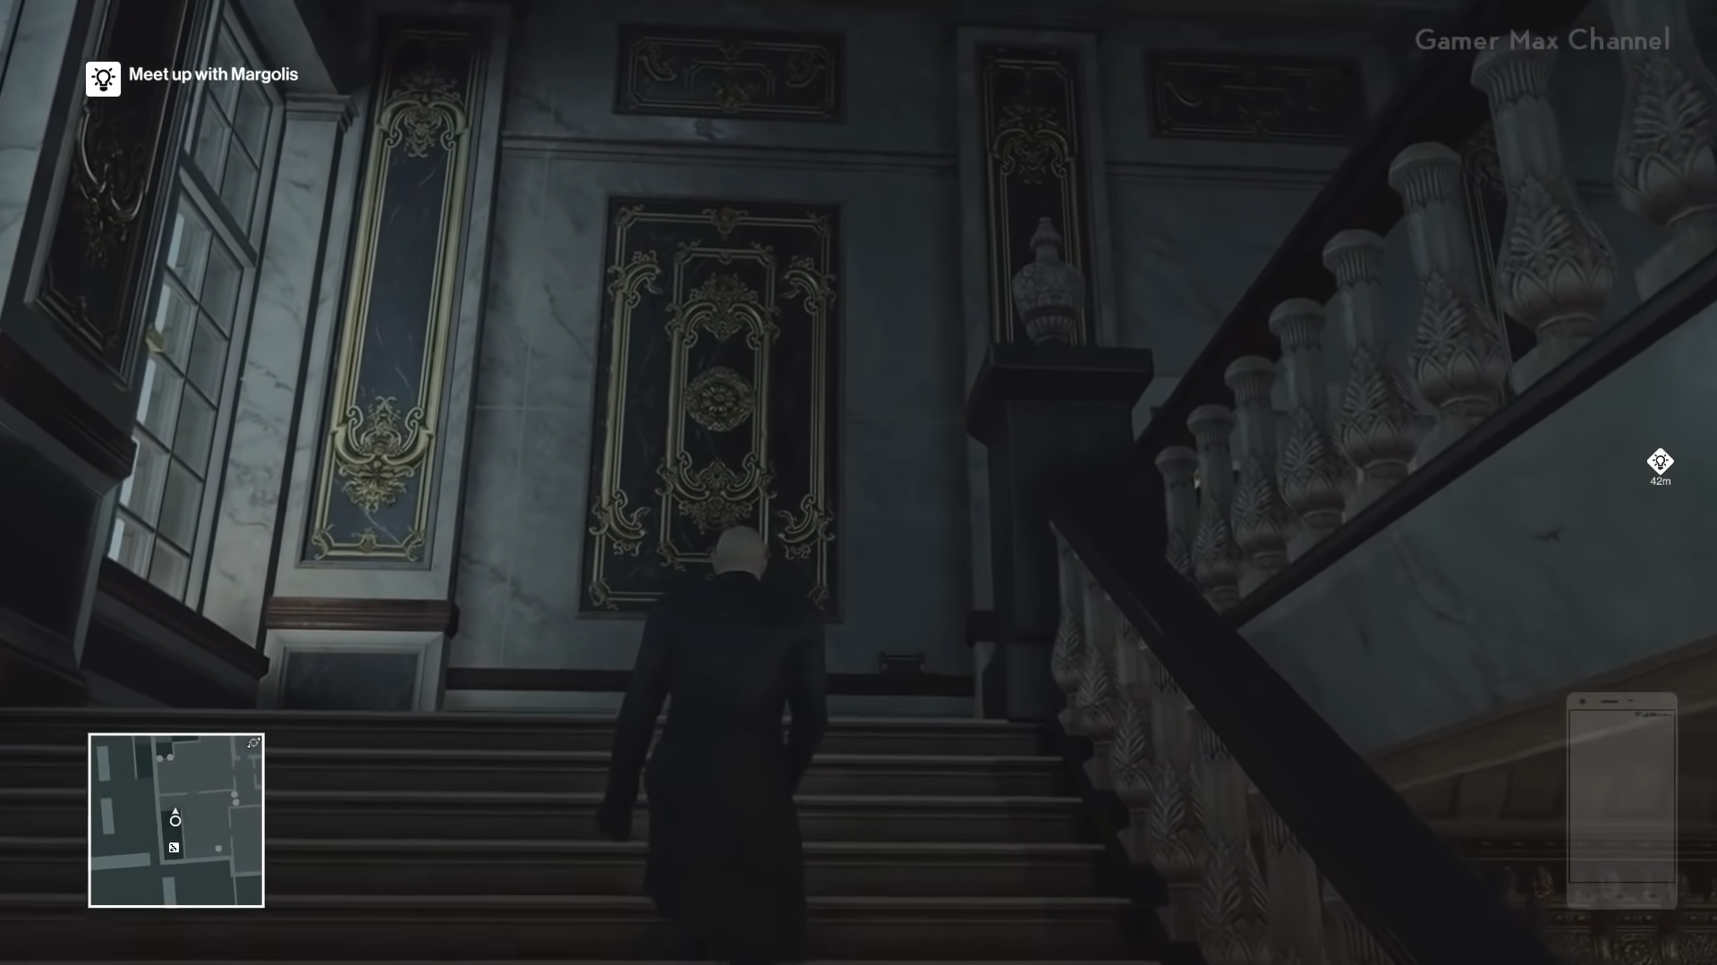
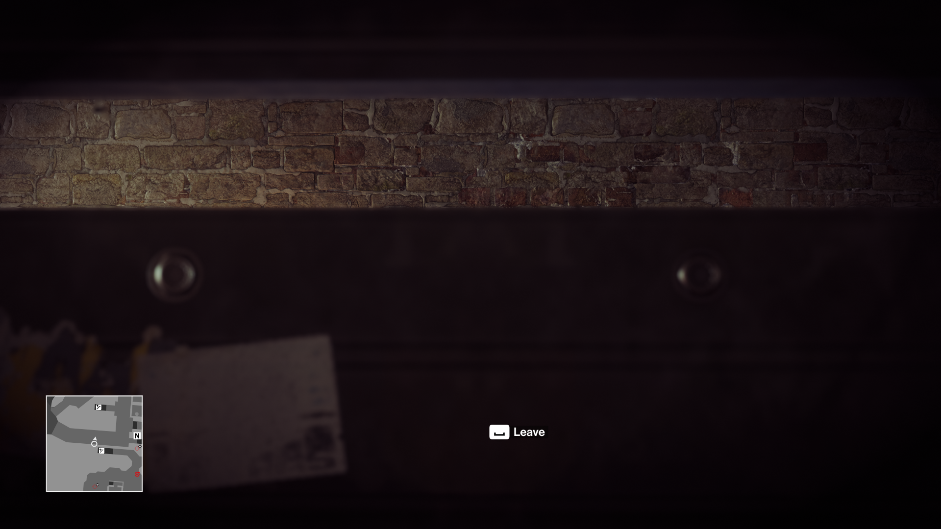
Emotion
Game Feel
Camera:
The TPS camera angle is used in the game.
The game camera switches to the appropriate angle so that the player can see the outside when he enters to hide.

Slide 21
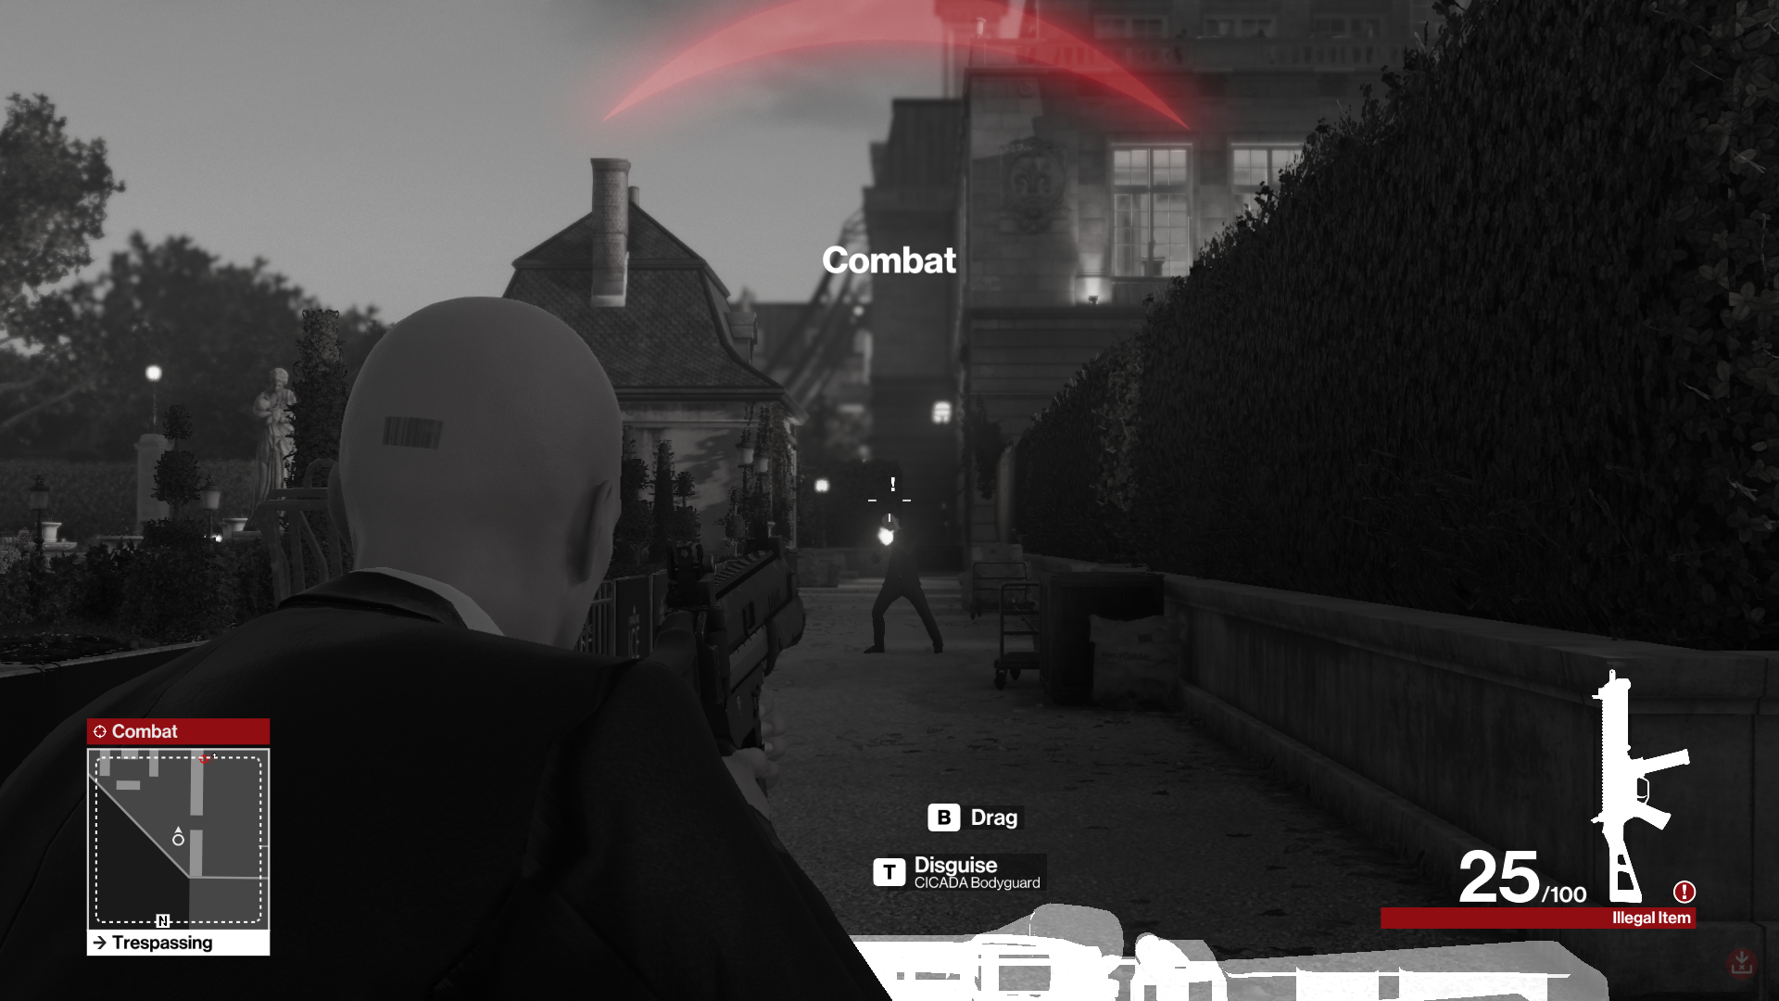
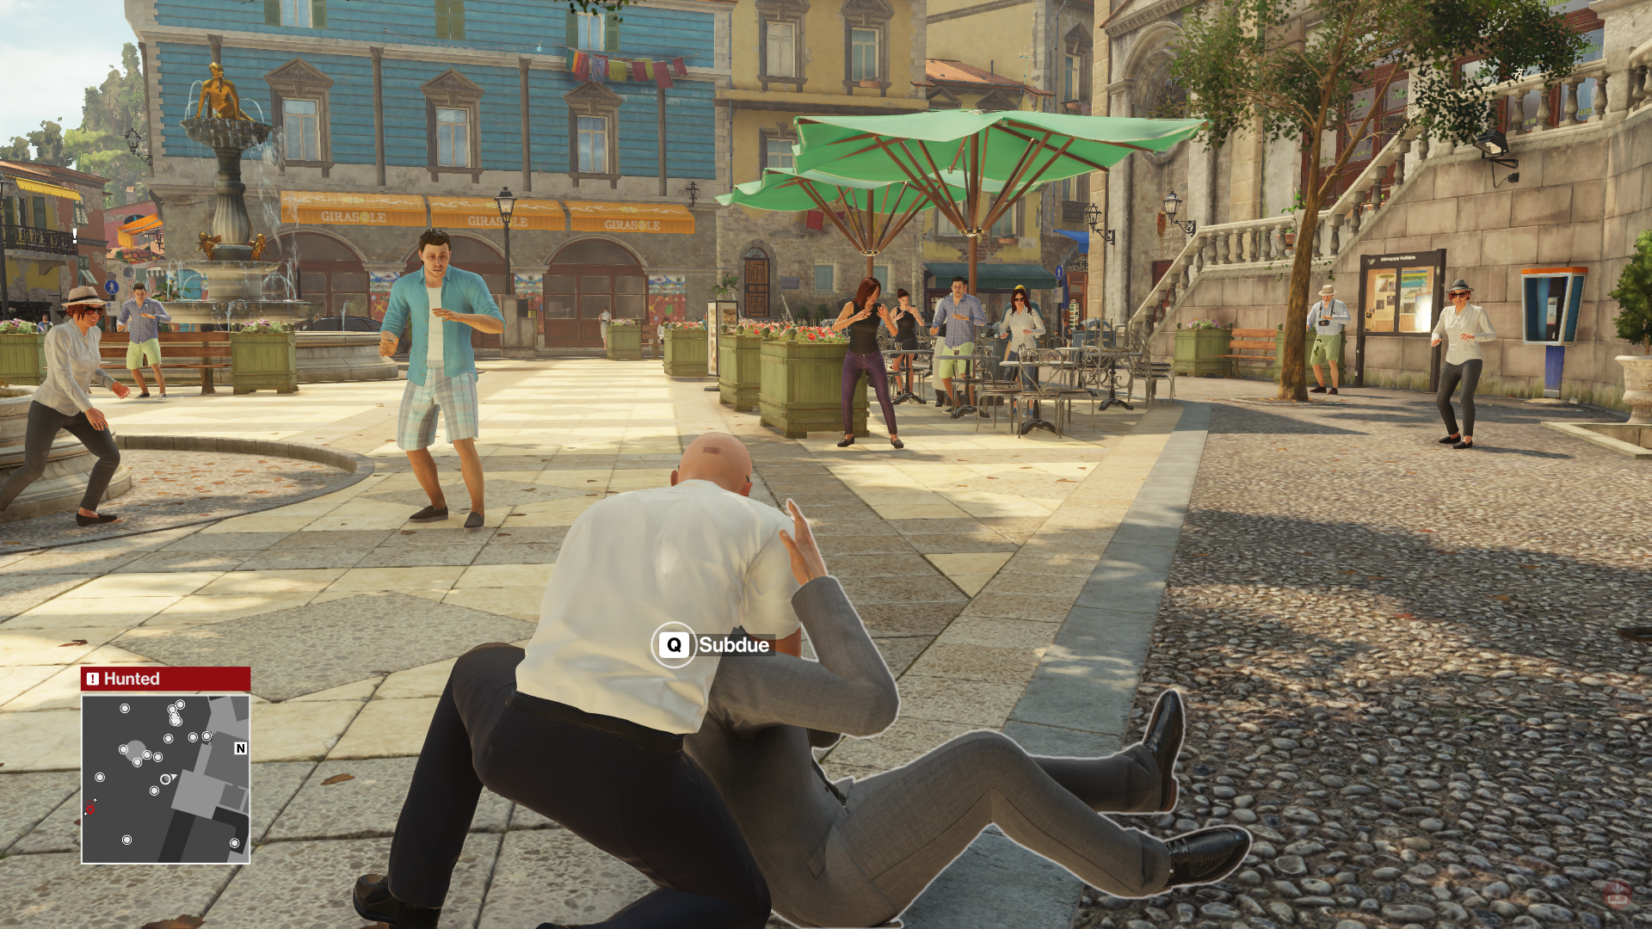
Emotion
Game Feel
Character:
The types of enemies and the fact that the enemies are armed differ in the game. For example, an ordinary NPC cannot attack us, while armed NPCs can shoot if they catch us.

Slide 22
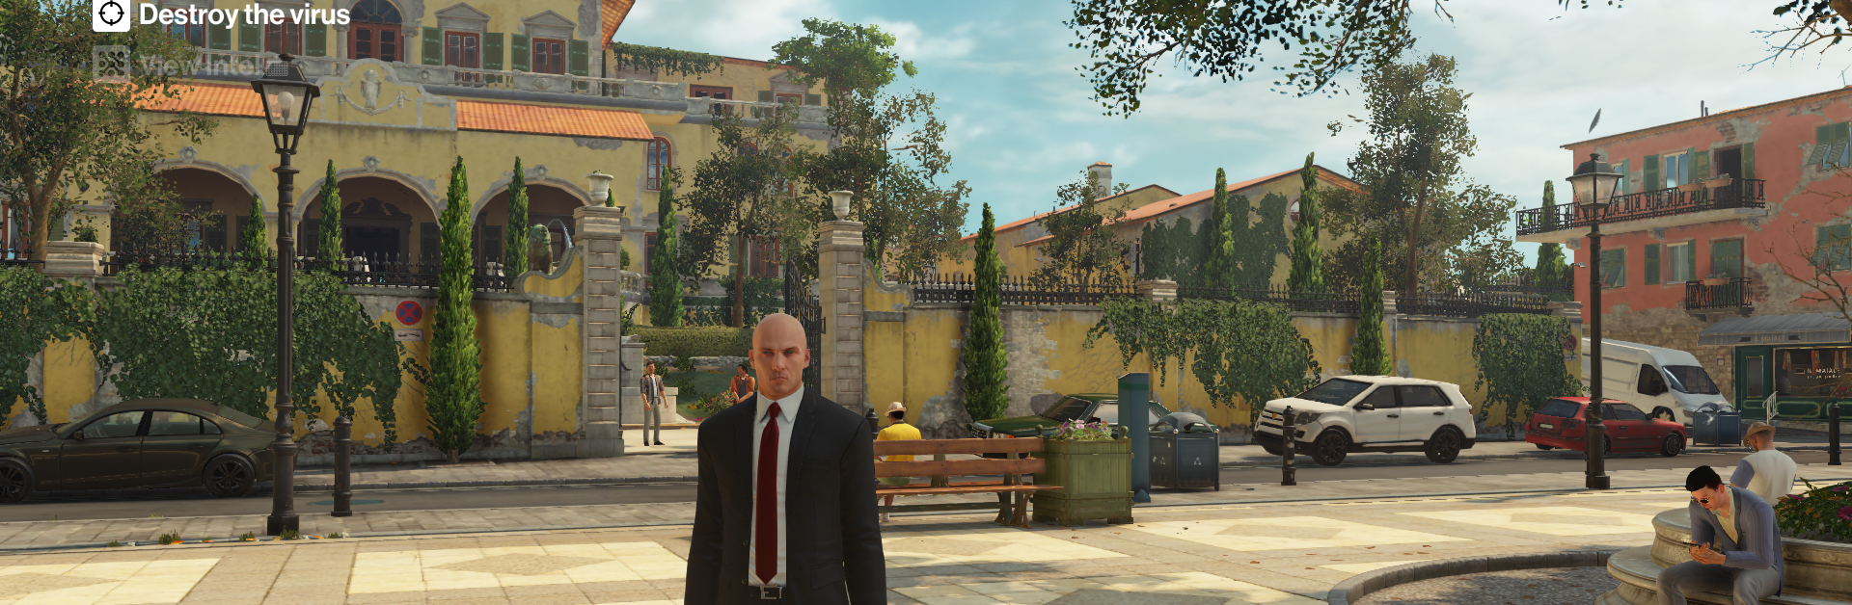
Since Hitman is a well-established game series, it is more likely for players who know this series to bond with the character.

Slide 23
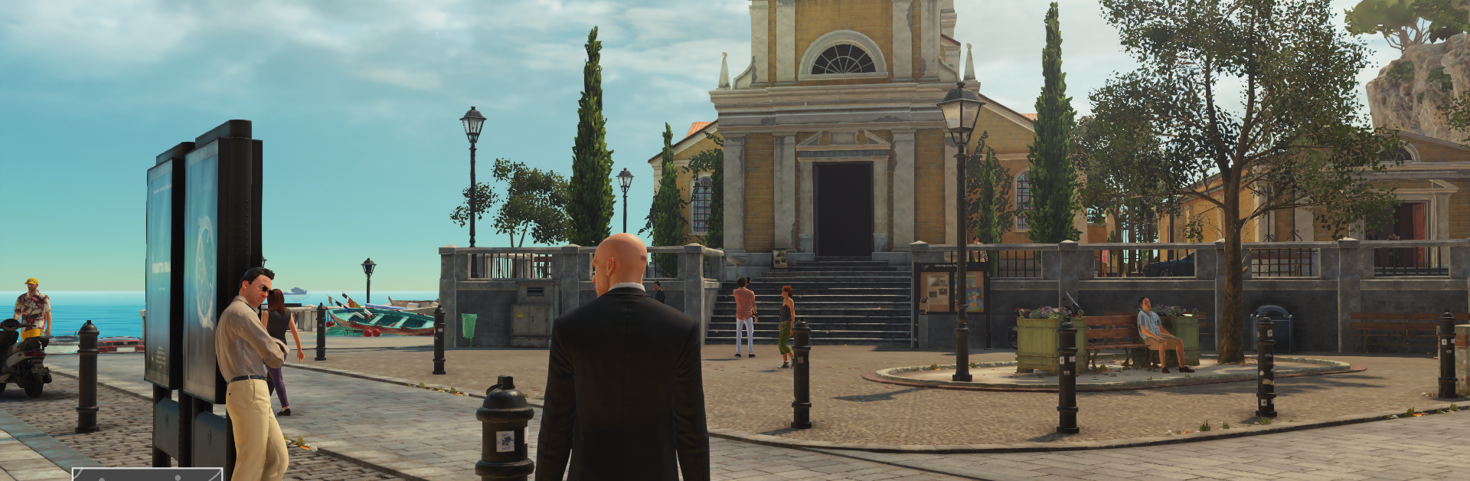
Emotion
Presence
Physical Presence:
The fact that the maps in the game like real-world environments can make the game more attractive.

Slide 24
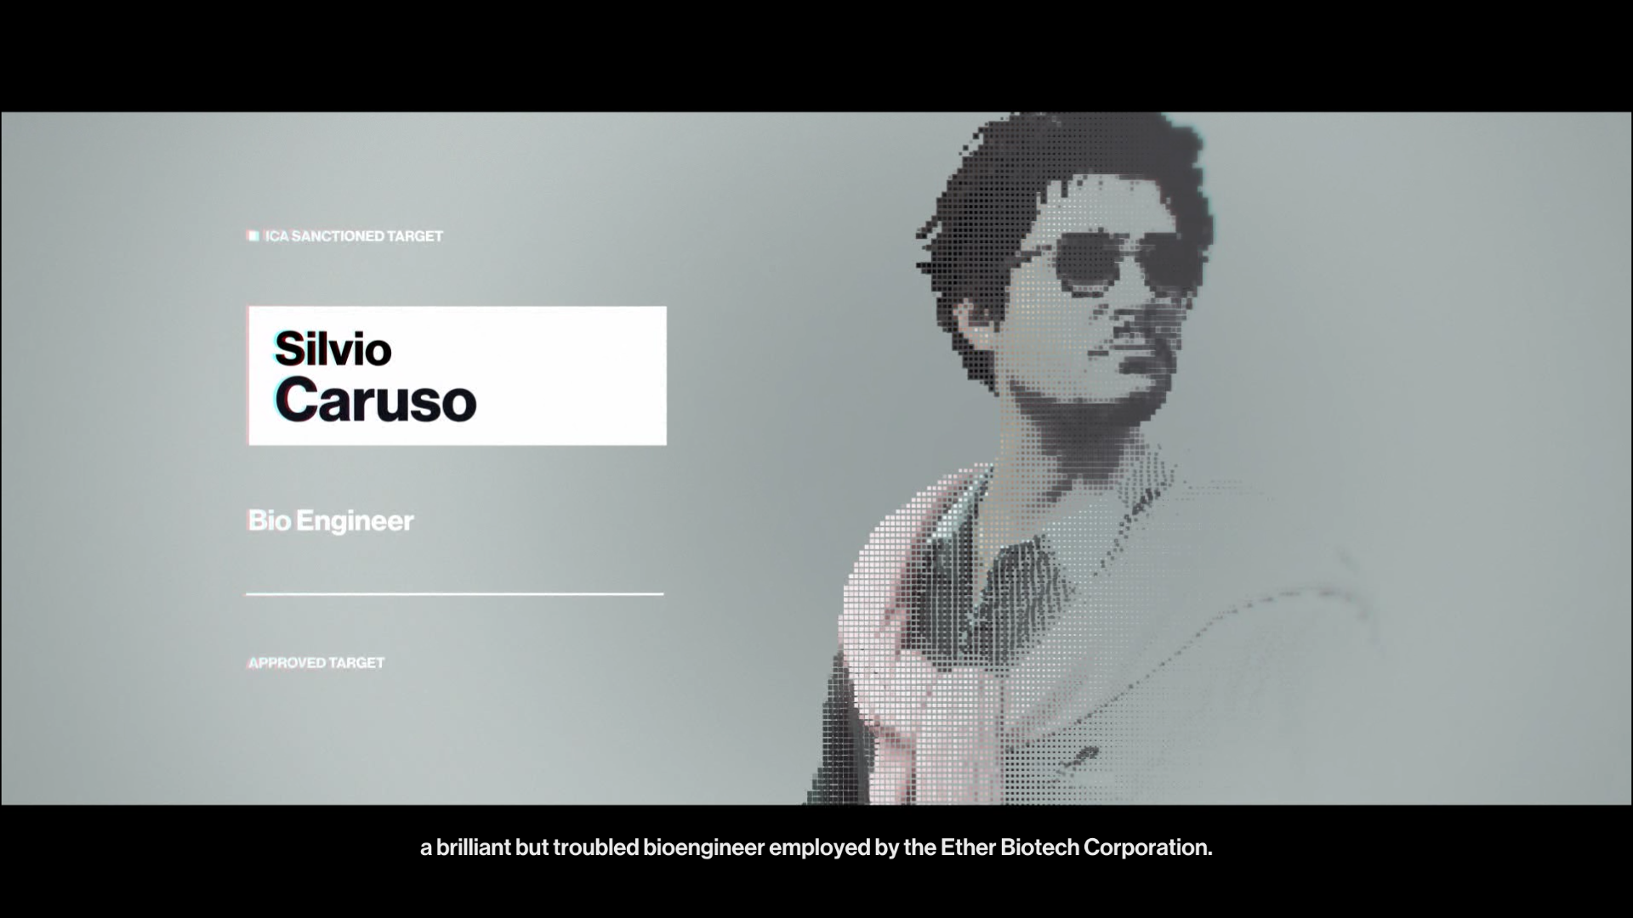
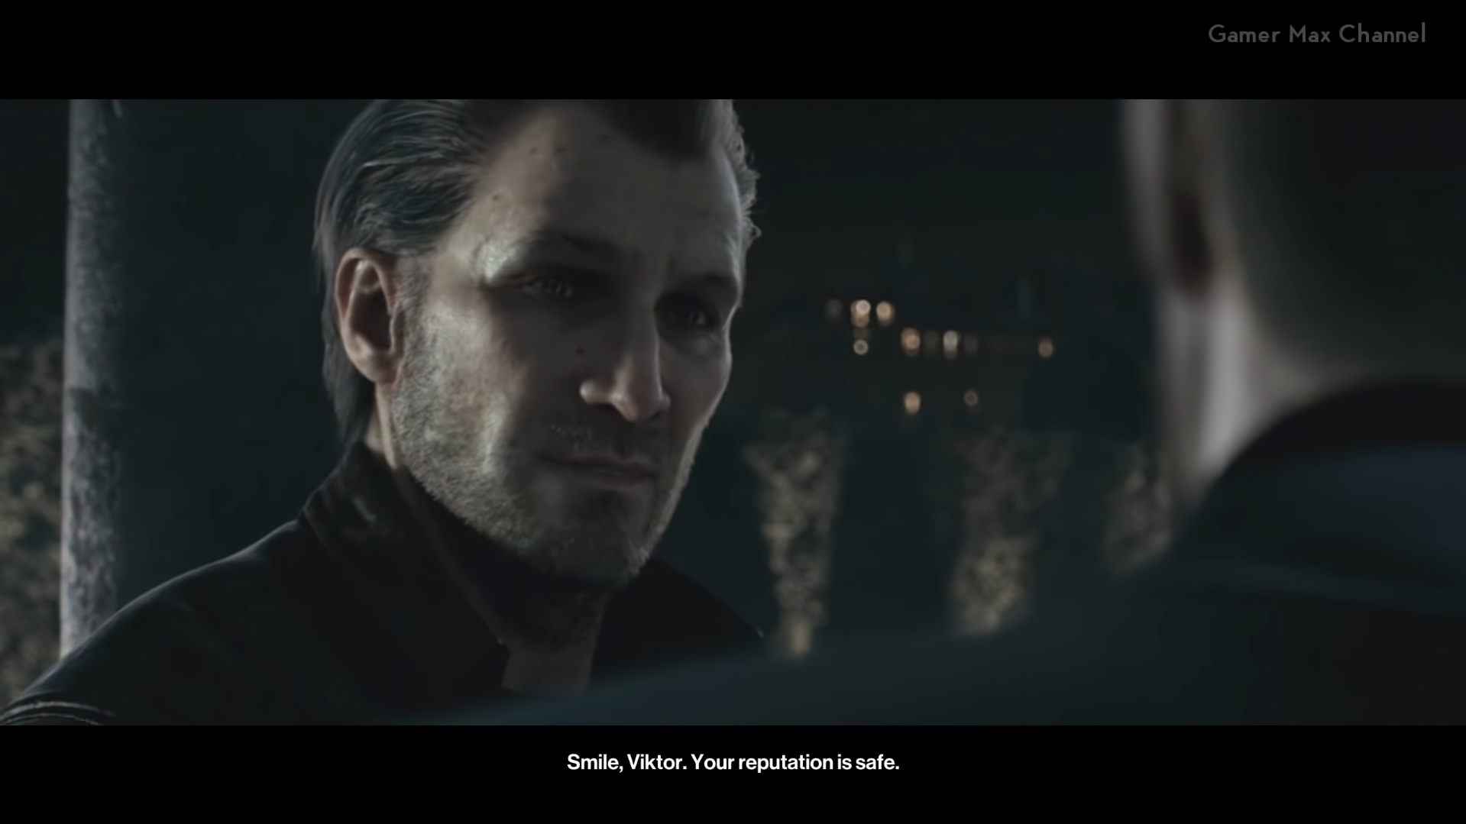
Emotion
Presence
Emotional Presence:
Cinematics before the mission introduces our targets and informs about the things they do.
The cinematics at the end of the mission give information about the story of the game.

Slide 25
Emotion
Narrative Presence:
It is impossible to make a choice that will affect the course of the story in the game.
Presence

Slide 26
Emotion
Discovery, Novelty and Suprises
When the R2 key is pressed, the target we need to kill is red, the objects we can kill are yellow, and the objects we can use and the NPCs that can notice us are white.

Slide 27
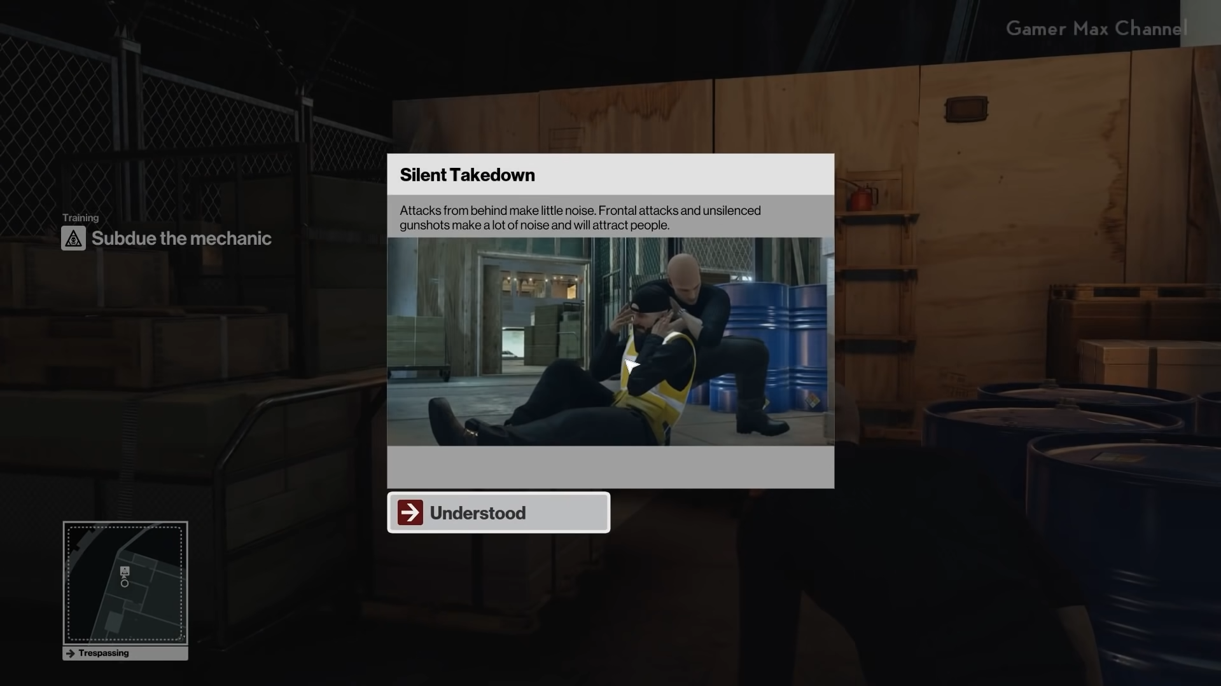
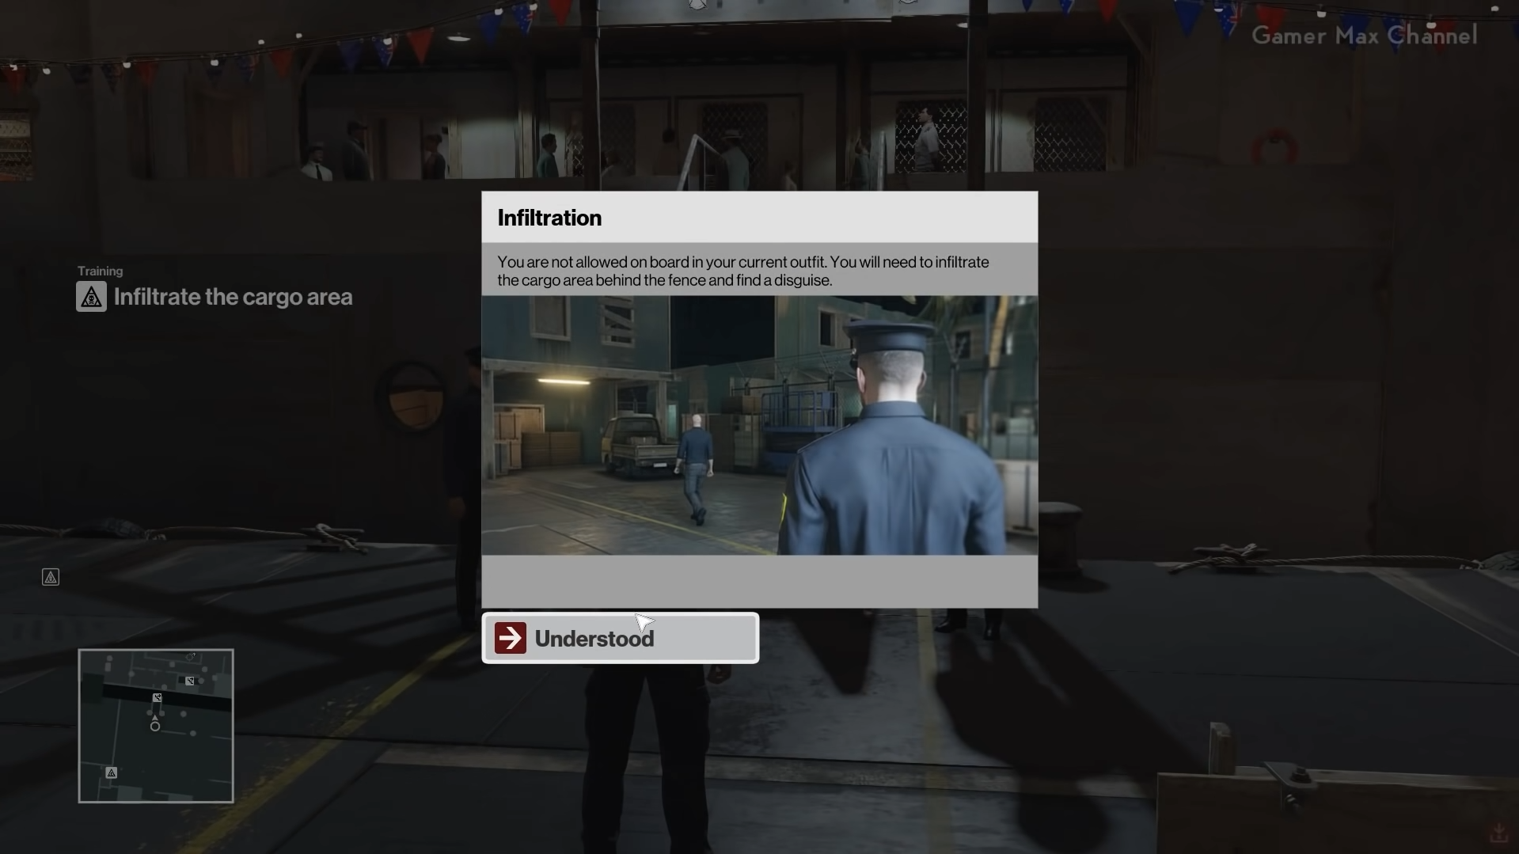
The mechanics in the game are taught in the tutorial level of the game, and no new features are added to the game later.

Slide 28
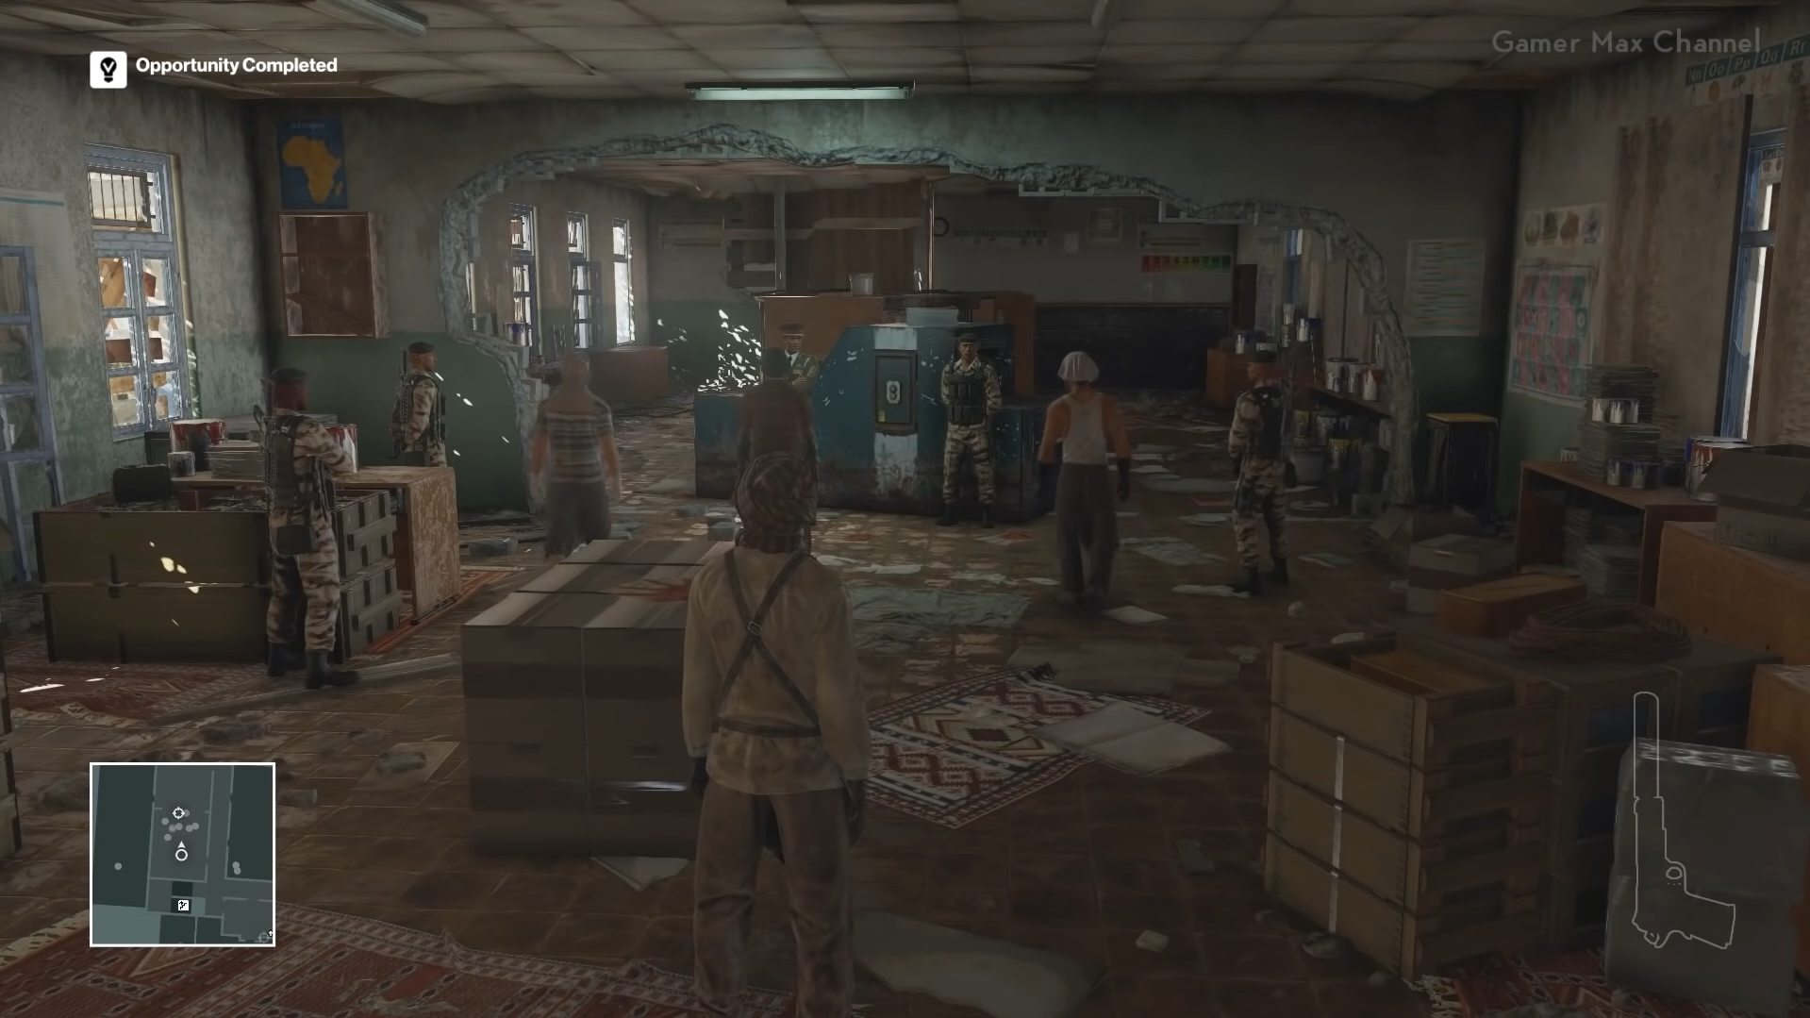
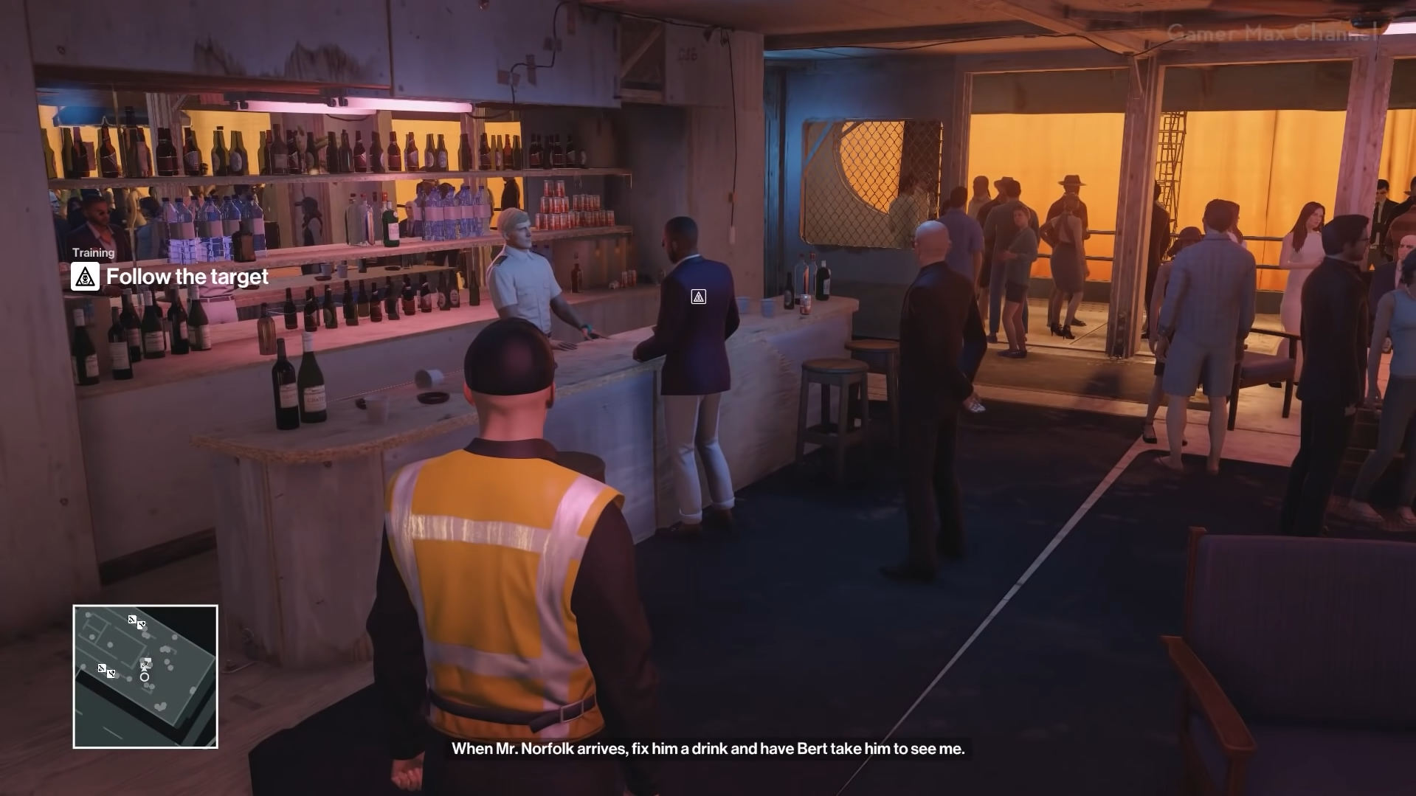
Game Flow
Difficulty Curve
Enemies and missions in the game become more difficult as the level progresses. In the last mission, we are trying to complete our mission in an area that contains more armed enemies than the first mission. Although this situation forces the player, the player can better plan the mechanics, potential dangers and the path he will take because he spends time in the game.

Slide 29
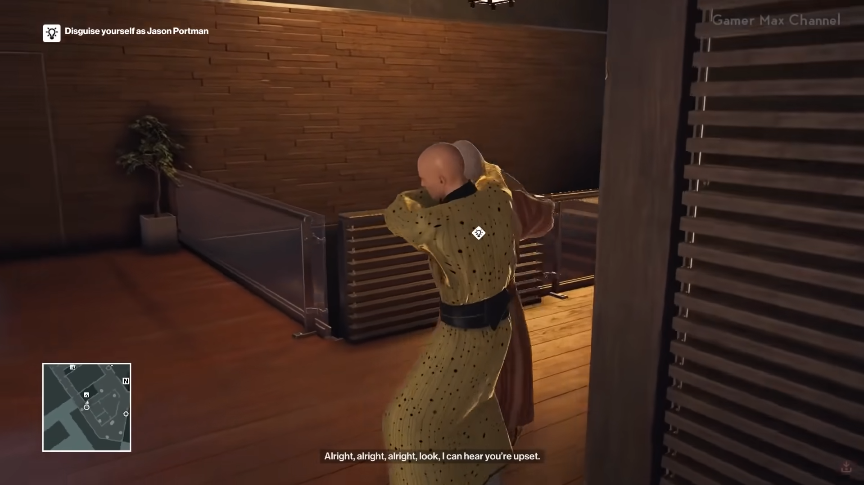
Game Flow
Learning Curve
The mechanics of the game are taught in the tutorial section the player masters as they play the game.

Slide 30

Thanks for listening

